Slide 1
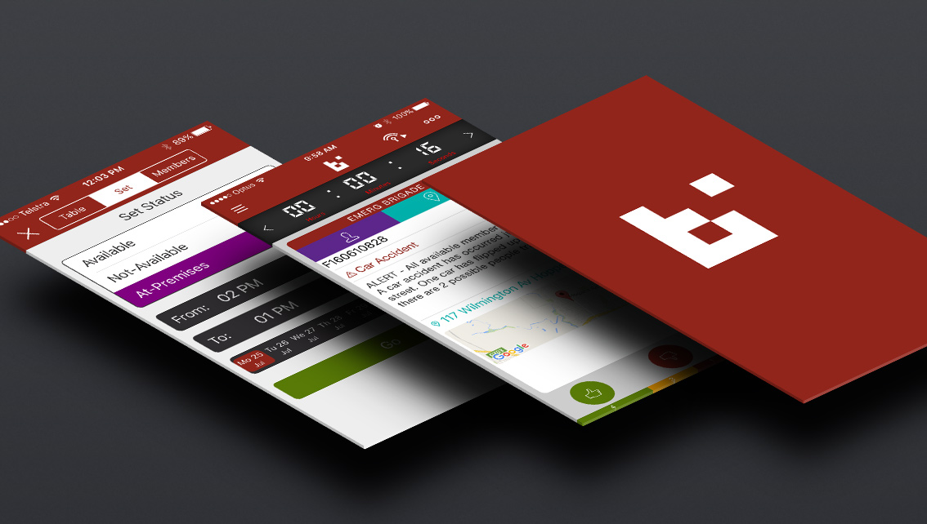


Agency Management Briefing
BART Platforms

Slide 2
What is BART?
It stands for: Broadcast. Alert. Respond. Turnout.
It currently comprises 3 different platforms that can service different types of users, functions and levels of incidents. They are:
Smartphone and tablet applications …
useful for Brigade operations and administration (at brigade and Area level)
A website programme called Dashboard …
which can be used to manage brigade and multi-brigade incidents
And a website programme called Turnout …
which enables Area or Regional level information collection and control
Soon, a new platform - RAMP, will provide a simple and visual way to keep track of appliances on and off the field …
RAMP will allow the management of resources across multiple agencies

Slide 3
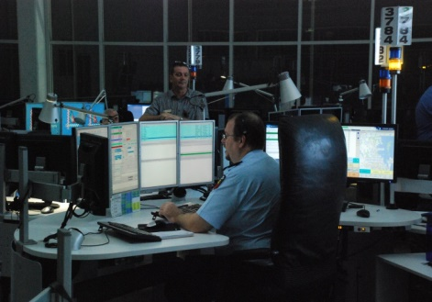
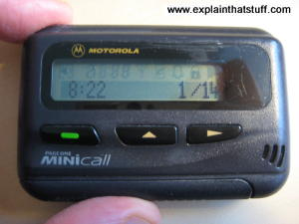
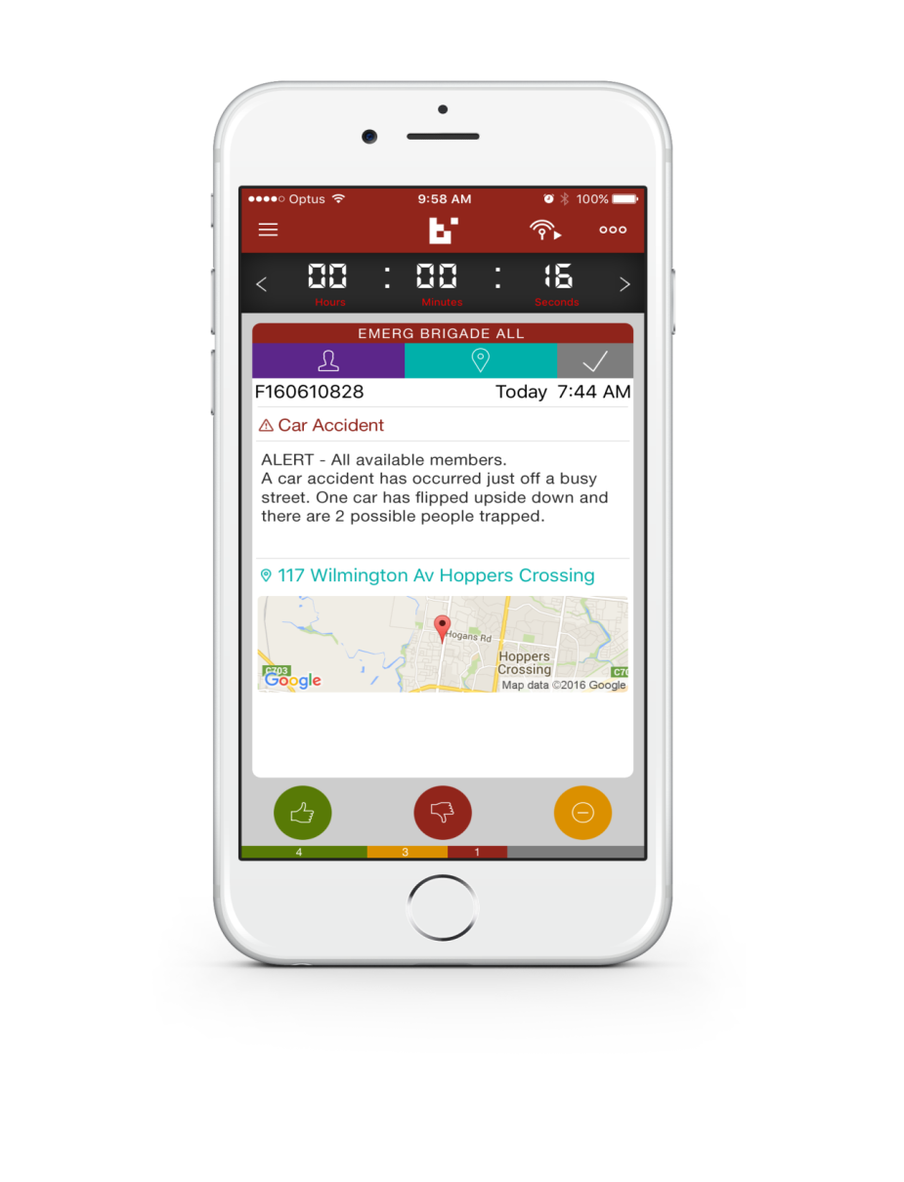
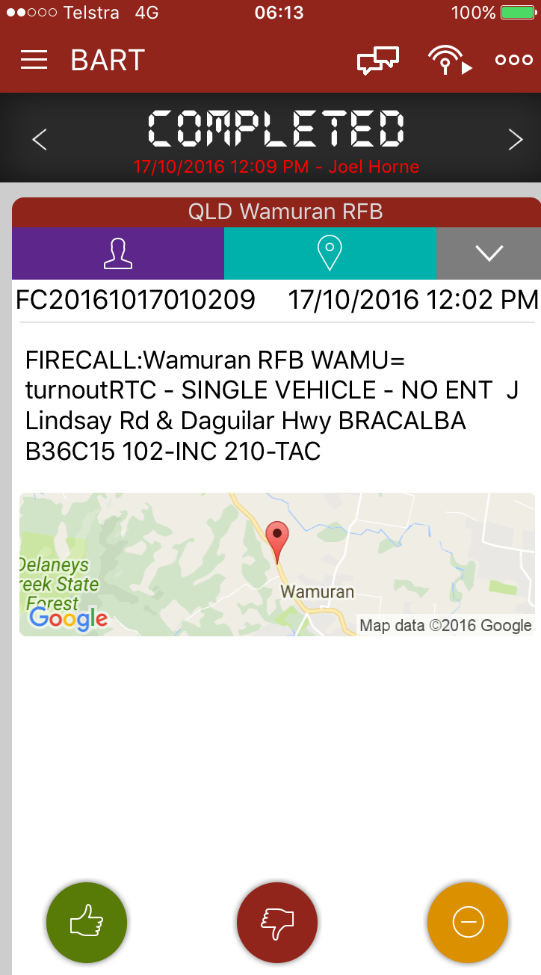
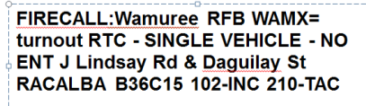
The Smartphone App
  An internet application that can capture pager and sms messages, then send and display those messages on smart devices (smart ‘phones and tablets).
Control
FIRECALL:Wamuree RFB WAMX= turnout RTC - SINGLE VEHICLE - NO ENT J Lindsay Rd & Daguilay Stwy RACALBA B36C15 102-INC 210-TAC
000
Paging
Service
BART
capture

Slide 4

The Smartphone App
Unfortunately, pagers can only show messages. Users then need to communicate by other means to identify additional information relevant to managing the incident
However, with BART:
  Users can show their status by a simple click on one of the following:
  It allows all other members of the brigade to see who is responding;
  when they will arrive; and
  their roles and skills.
  If an address is included in the message, BART includes a map showing the location of the incident, with routes and timings from home to the station and from the station to the incident.

Slide 5
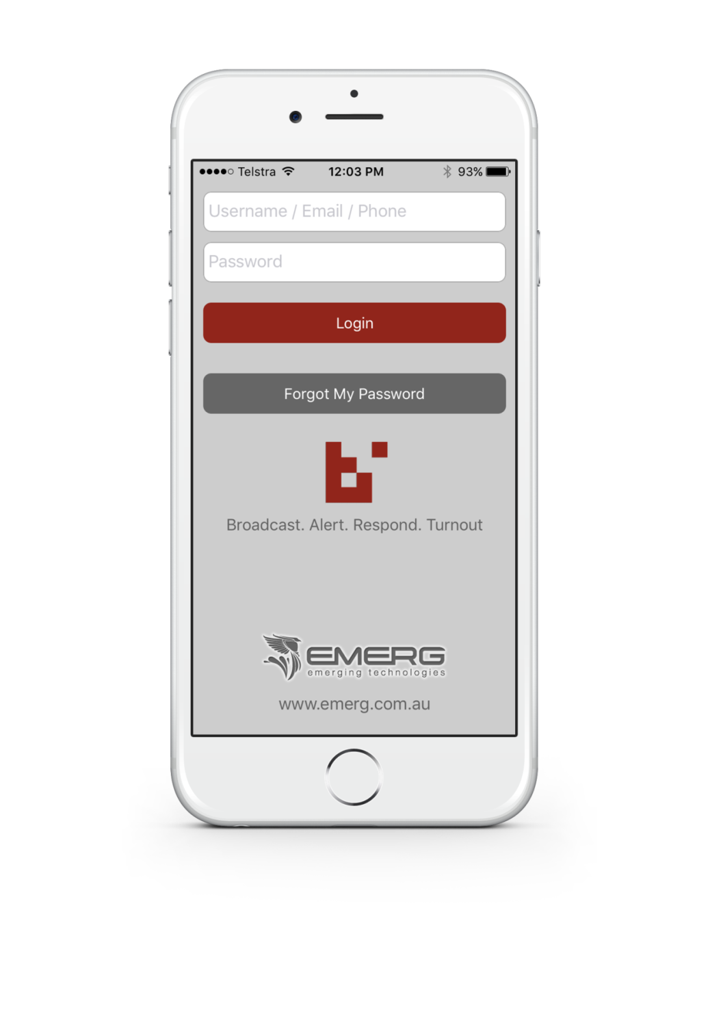
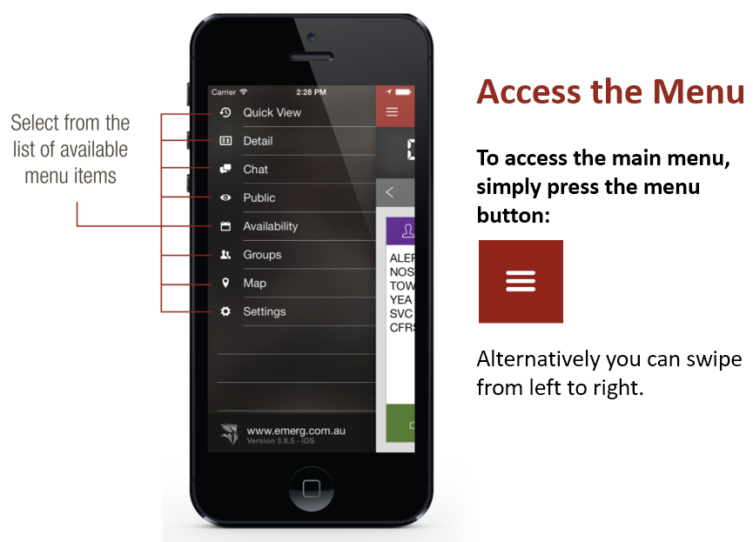
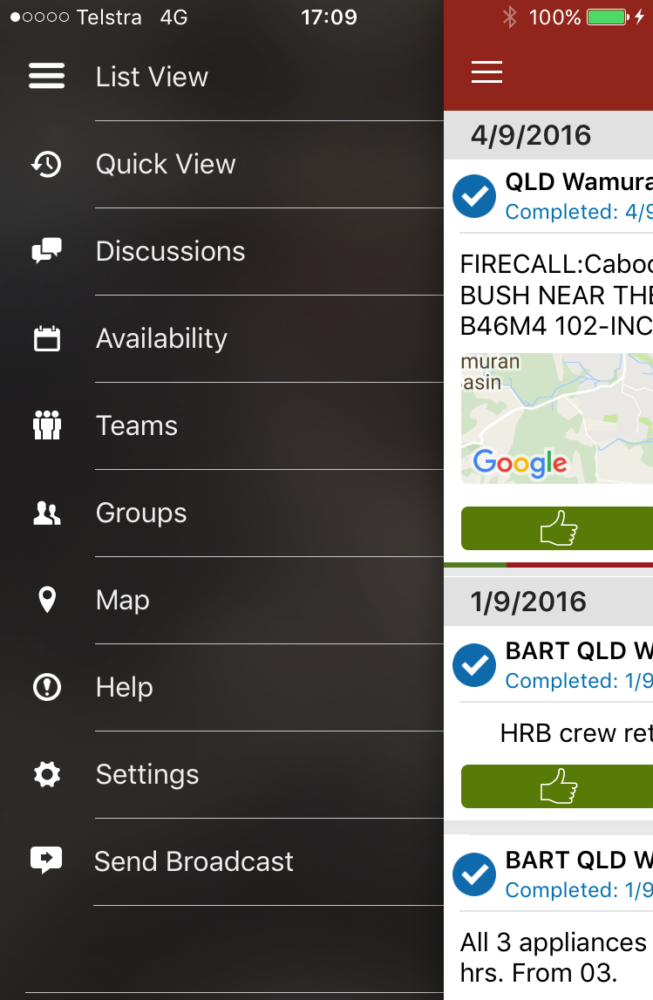
Accessing the Menu
Notes:
It has a comprehensive menu which can be accessed by clicking on the three bars or swiping from left to right

Slide 6
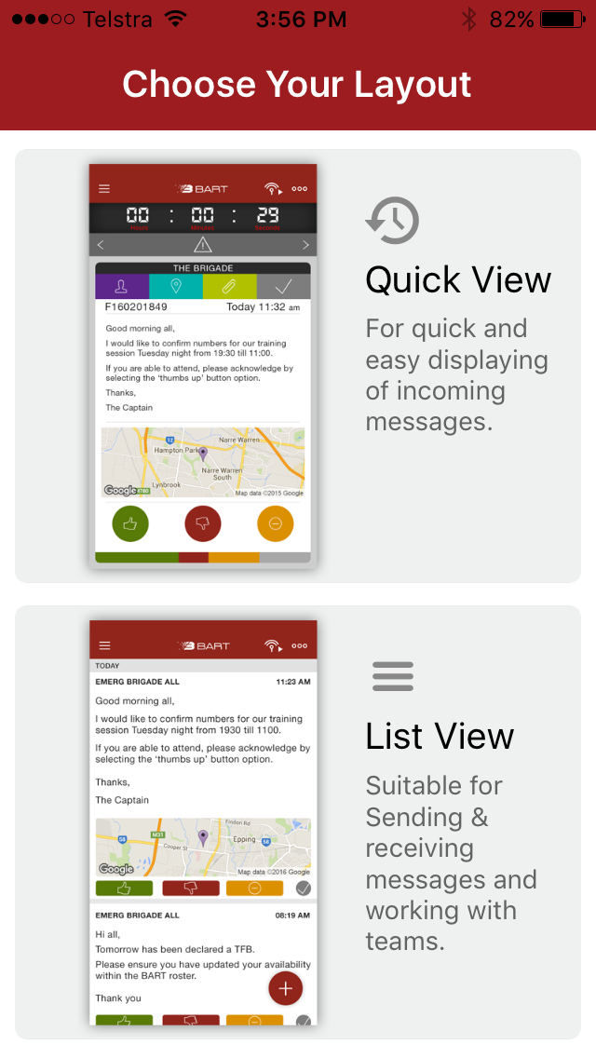
This is what the app looks like on a smart phone.
It has 2 views:
Quick View ( one event at a time); and
List View (several events)
Smartphone Application

Slide 7

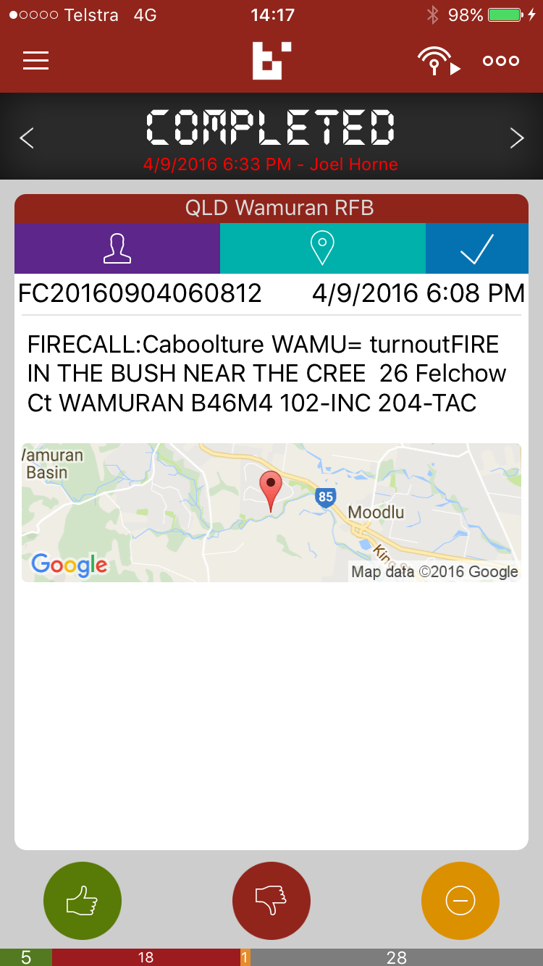
A Firecall – in Quickview
Message text
Geotagged map
Tap thumbs up: YOU ARE attending
Smartphone Application

Slide 8
Click to see who’s attending
Smartphone Application

Slide 9
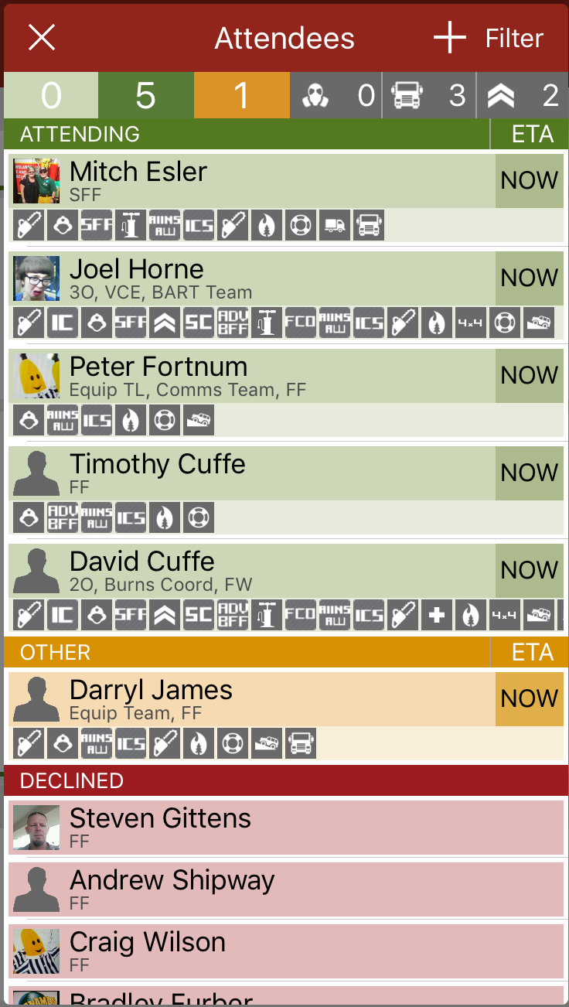
and see:
names
photos
roles
qualifications
arrival time
5 M
Smartphone Application

Slide 10
Click on the map
Smartphone Application

Slide 11
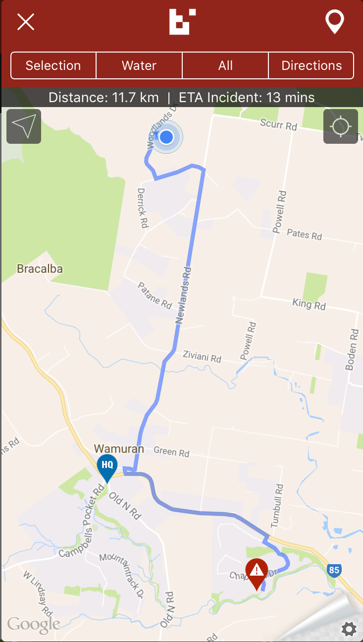
And see……..
the route from home to the station
… and from the station to the incident
the location of the incident
Smartphone Application

Slide 12
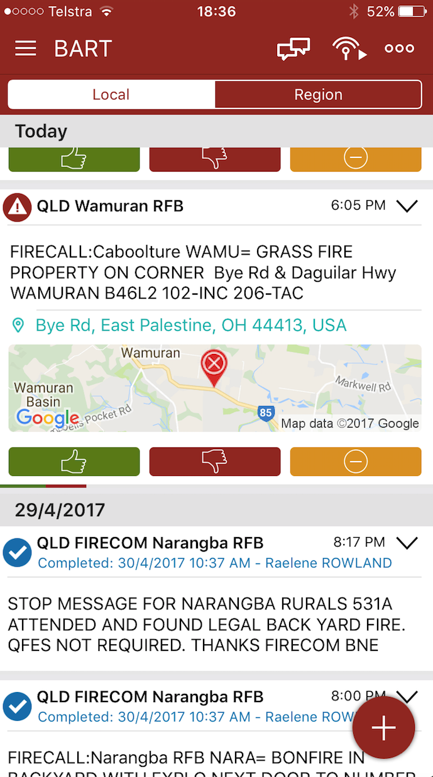
List View
List View allows a number of incidents to be seen on the screen
Clicking on the three dots opens member locational options
In List View, click on the text to see who is attending
When crews return from an incident or HRB, the incident can be completed and then hidden if required

Slide 13
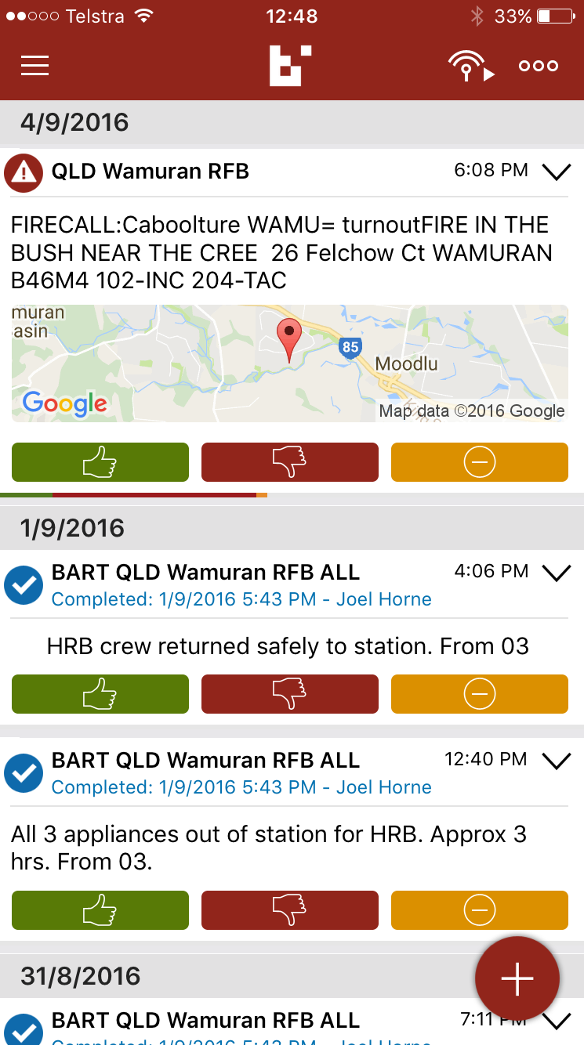
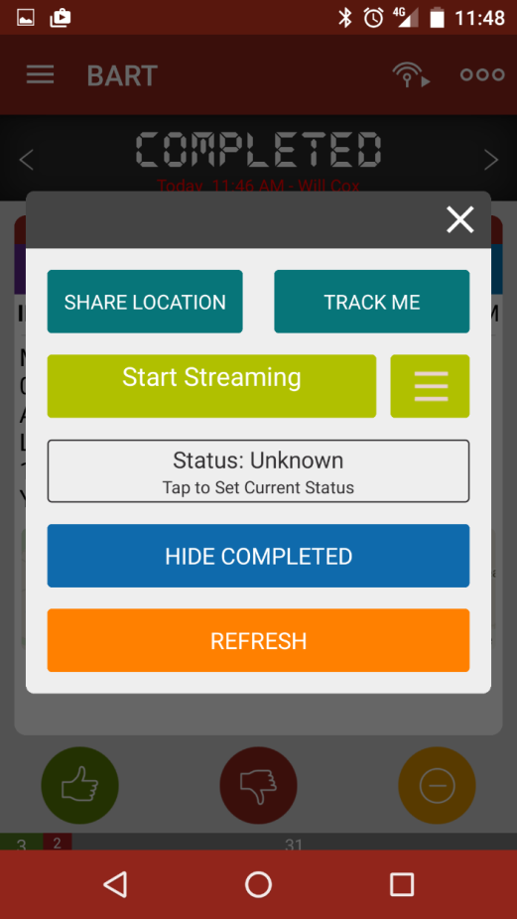
This will show your current location but not track you
This feature is useful for identifying the location of an ICP, staging area, etc
The Track Me feature will track you on the map
Note: Tracking will stay enabled for 1 hour – Good for FF & Appliances
Hides Completed jobs
Updates and closes this screen
Advanced Options (3 dots) Screen

Slide 14


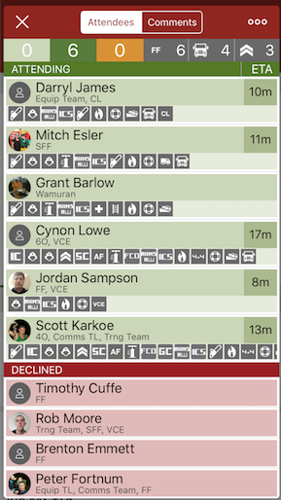
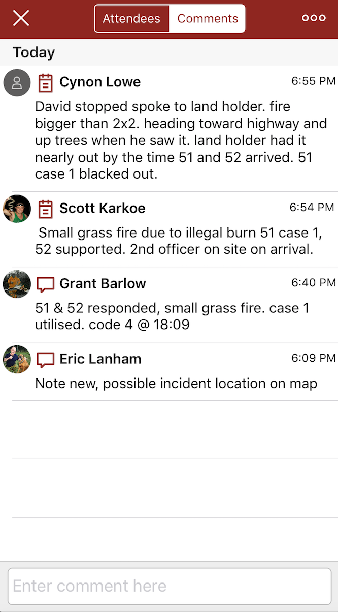
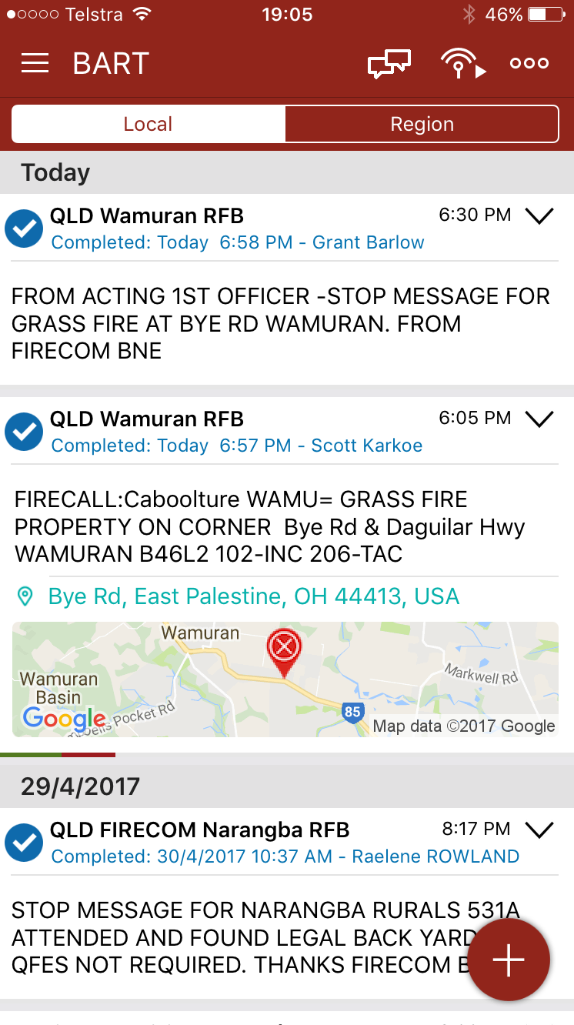
A new feature included in the latest BART update allows for a log to be created by adding comments inside an incident. This is accessed by clicking the Comments button on the screen
Completing the incident triggers BART to produce an Incident Report which can be emailed to both brigade management and Area Office (for updating OMS)
Smartphone Application

Slide 15
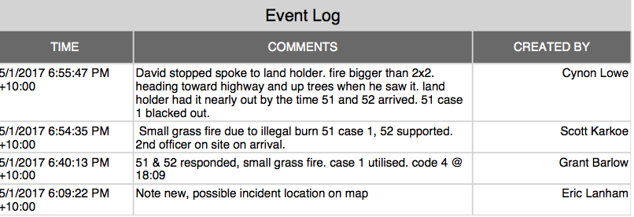
A report generated by BART based on Incident completion
Area Office
This automated report eliminates the need for RFB to complete RF 14 or other documentation Creating an incident within BART , e.g., a HRB, also causes BART to produce a report when the job is completed.
RFB
(select addressees)

Slide 16
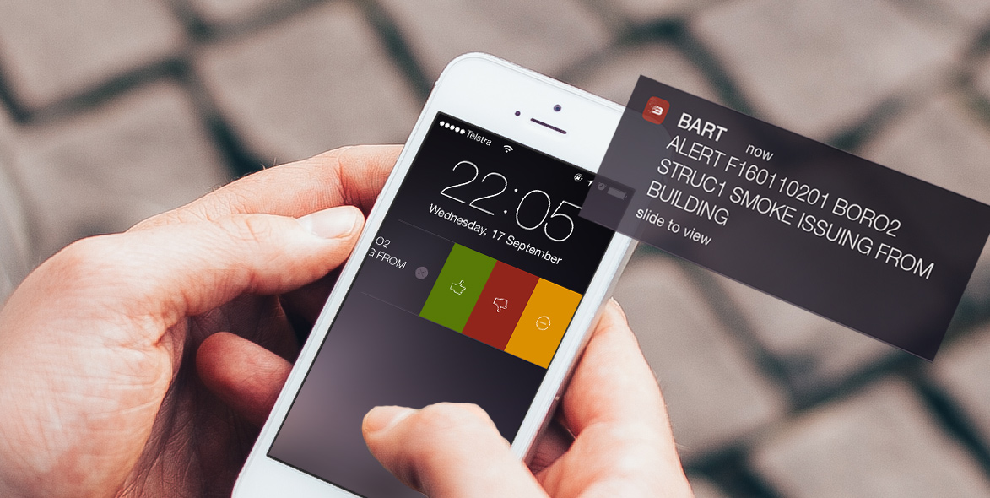
You can slide the Push Notification from your lock screen to respond directly to the alert or message
Respond from Push Notification

Slide 17
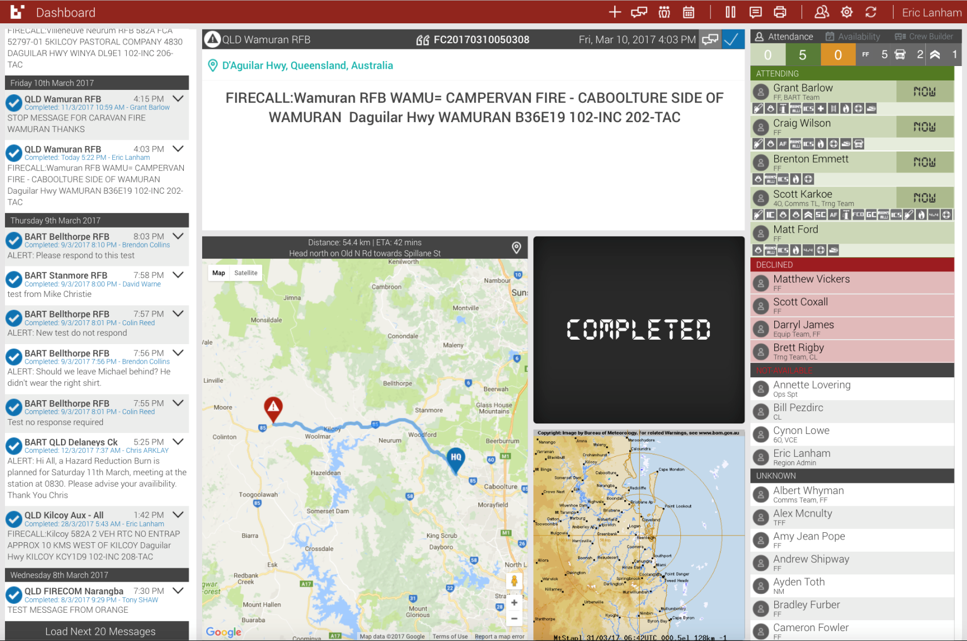
Dashboard
What is it? ….. a website programme that can be used to manage brigade and multi-brigade incidents

Slide 18
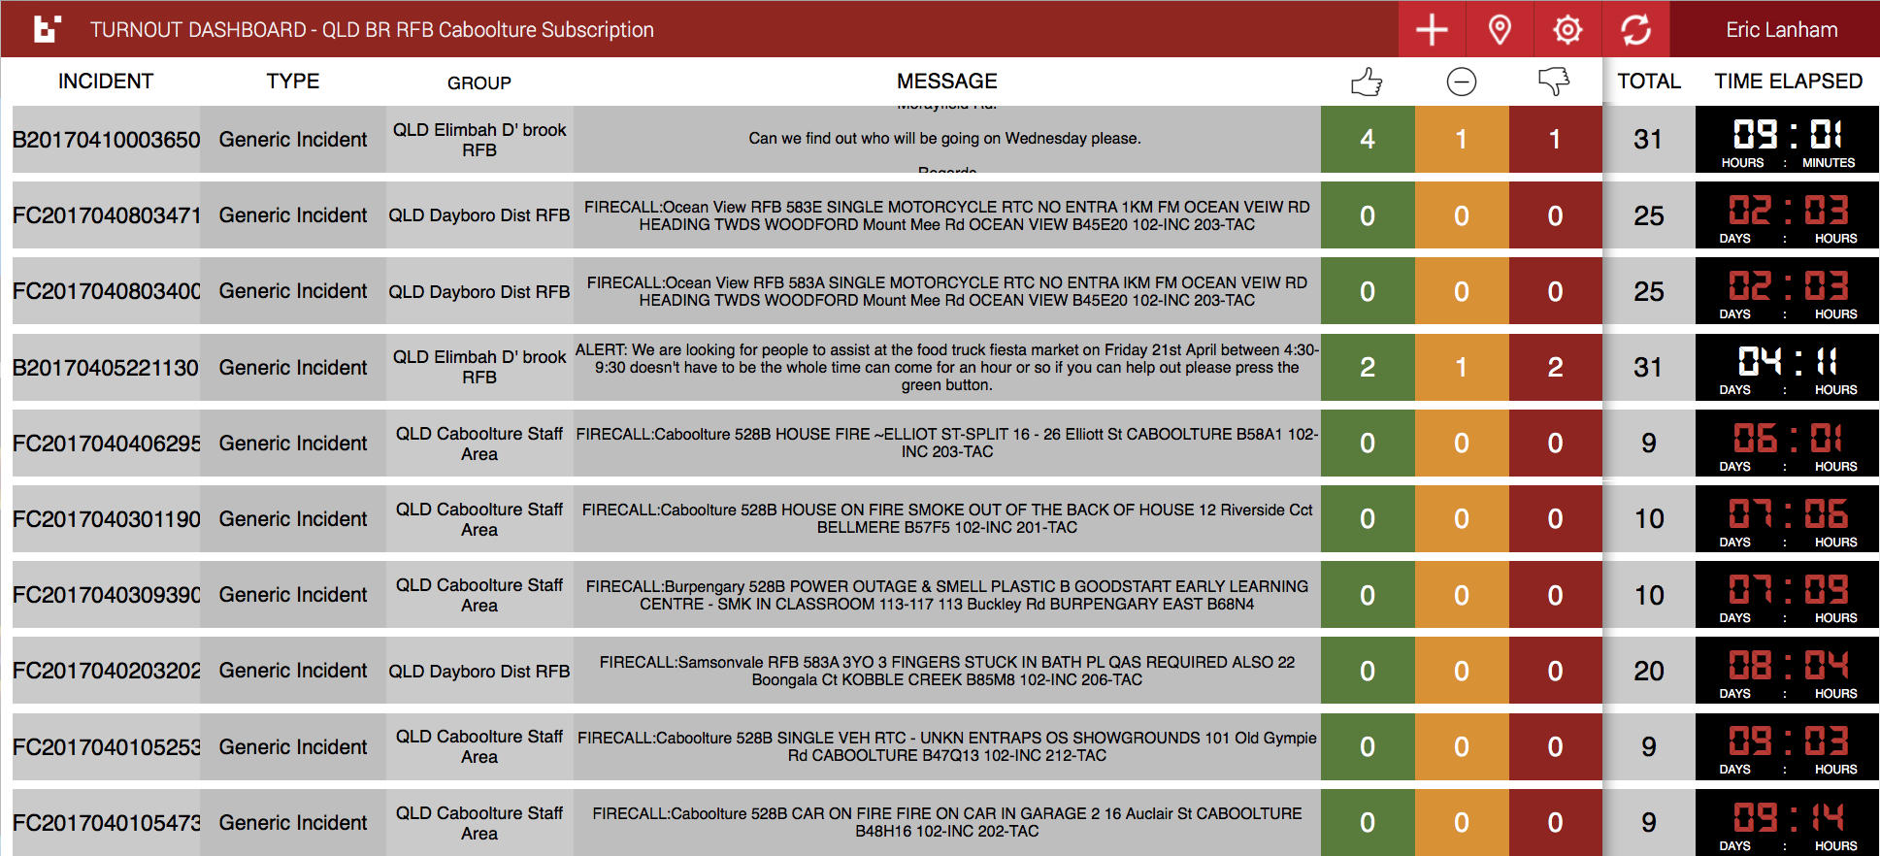
Turnout
What is it? ….. A website programme for Area or Regional level information collection and control

Slide 19
Our Region is trialling BART as a response management system
Why?
Because BART…
  is a cost effective way of using available technology to communicate with each other for RFS purposes
  It provides features to increase the efficiency of response activities and enhance communications at the Brigade, Group, Area and Regional level

Slide 20

How will BART affect our RFBs?
It will make the way they communicate their intentions about an incident easier and quicker;
It allows crews to be assigned to appliances
It will act as a GPS and show FF the way (and time) to the incident
It allows FF and Appliances to be tracked on the fireground;
It provides CL or IC with a voice or text input into an incident log;
It enables first arriving crews to verify or change the incident location;
It allows the automatic generation and delivery of reports concerning brigade activities to both brigade and Area management;
The Teams and Discussion features within BART also enables enhanced and focussed communication within brigades; and
BART allows the FO/IC to more effectively manage response

Slide 21
How will BART affect Areas and Regions
It will provide a C³ network between Region, Area, Group and Brigades, for example:
It will enhance the speed at which deployment teams can be identified, assembled and deployed, because:
  Area Office or Groups can request deployment members and appliances direct from First Officers in a very short time
  Members can be assigned to appliances prior to deployment;
  Members of teams will have an additional intra-team communications network, which can also be accessed by the AD and RM; and
  Deployment teams will be able to maintain a continuous log during the deployment which will provide valuable information for post deployment feedback.

Slide 22
In summary, BART is an attractive option for RFS, because:
It is an application that can provide an array of features, increased efficiencies, wider and faster communications for end users, Area and Regional management, for very little cost;
As seen in other states, it may also be suitable for SES and other volunteer organisations;
It uses technology consistent with current trends;
Has been developed by a company with a reliable logistics service ethic that has proven to be attentive to the requirements of users; and
Is already partially integrated with a Tier One CAD solution
Brigade Requirements

Slide 23
Challenges
Members need to be:
prepared to embrace technology;
willing to use their smartphones (which need to have a data allowance);
prepared to pay for data usage, although BART data usage is very lean;
A backup system is required for those who don’t have smart phones;
There needs to be Internet and/or sms coverage;
Brigades must be prepared to administer the system within their brigade, group, etc ; and
There needs to be an examination of any potential for privacy issues.
Brigade Requirements

Slide 24
?
Questions?

