Slide 1
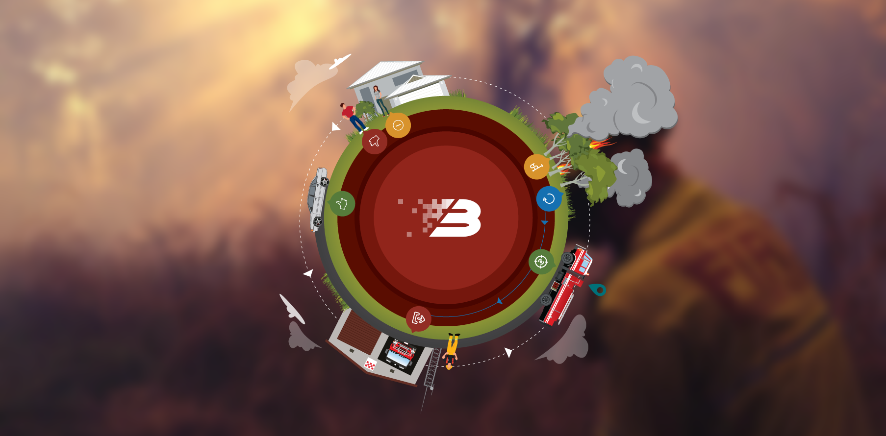
BART a complete solution for the entire turnout process
By the BART Team, at Emerg DATE: 18/05/2017
Notes:
Thank you for allowing me share what we have learnt so it may help you develop world standard App applications.
Happy to answer questions

Slide 2
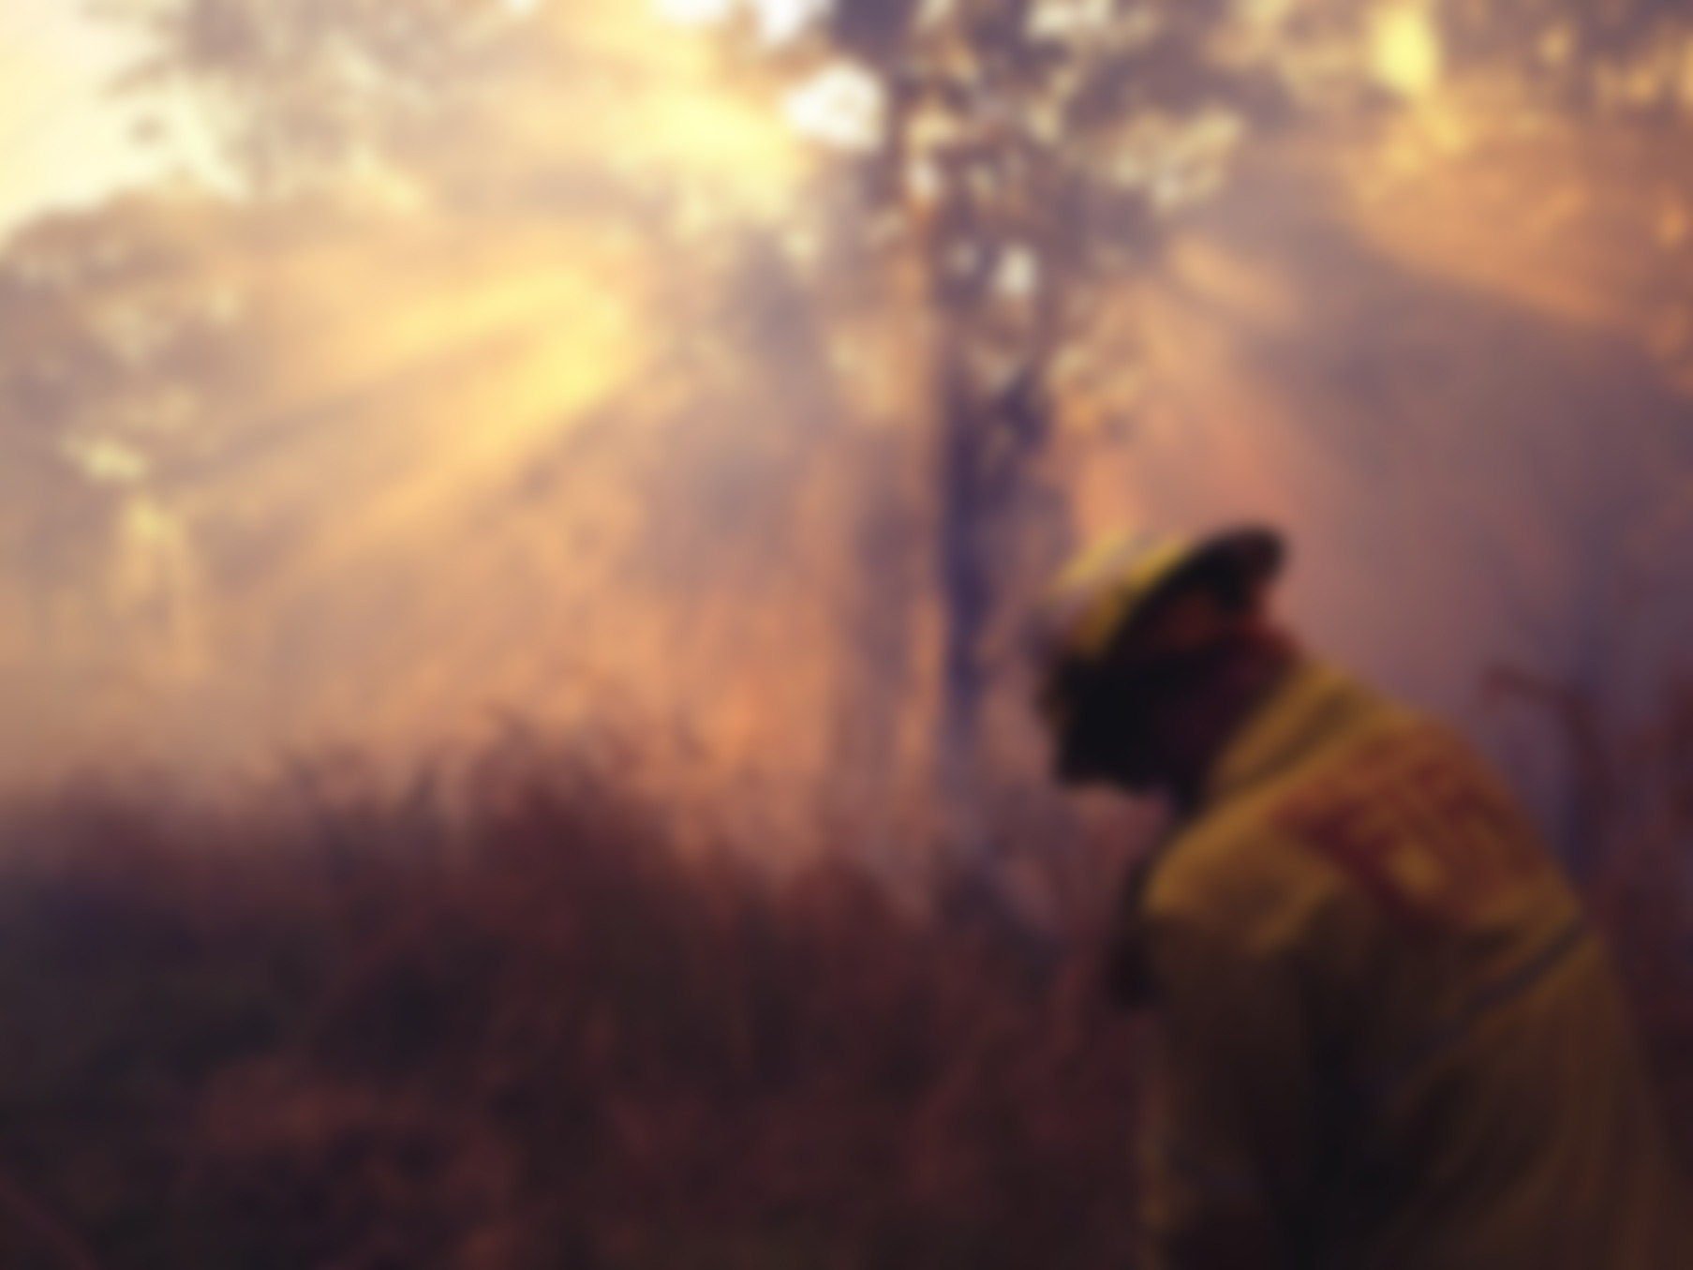
Emergency Personnel
who get up at 3am in the morning
to help other members of
their community

Slide 3
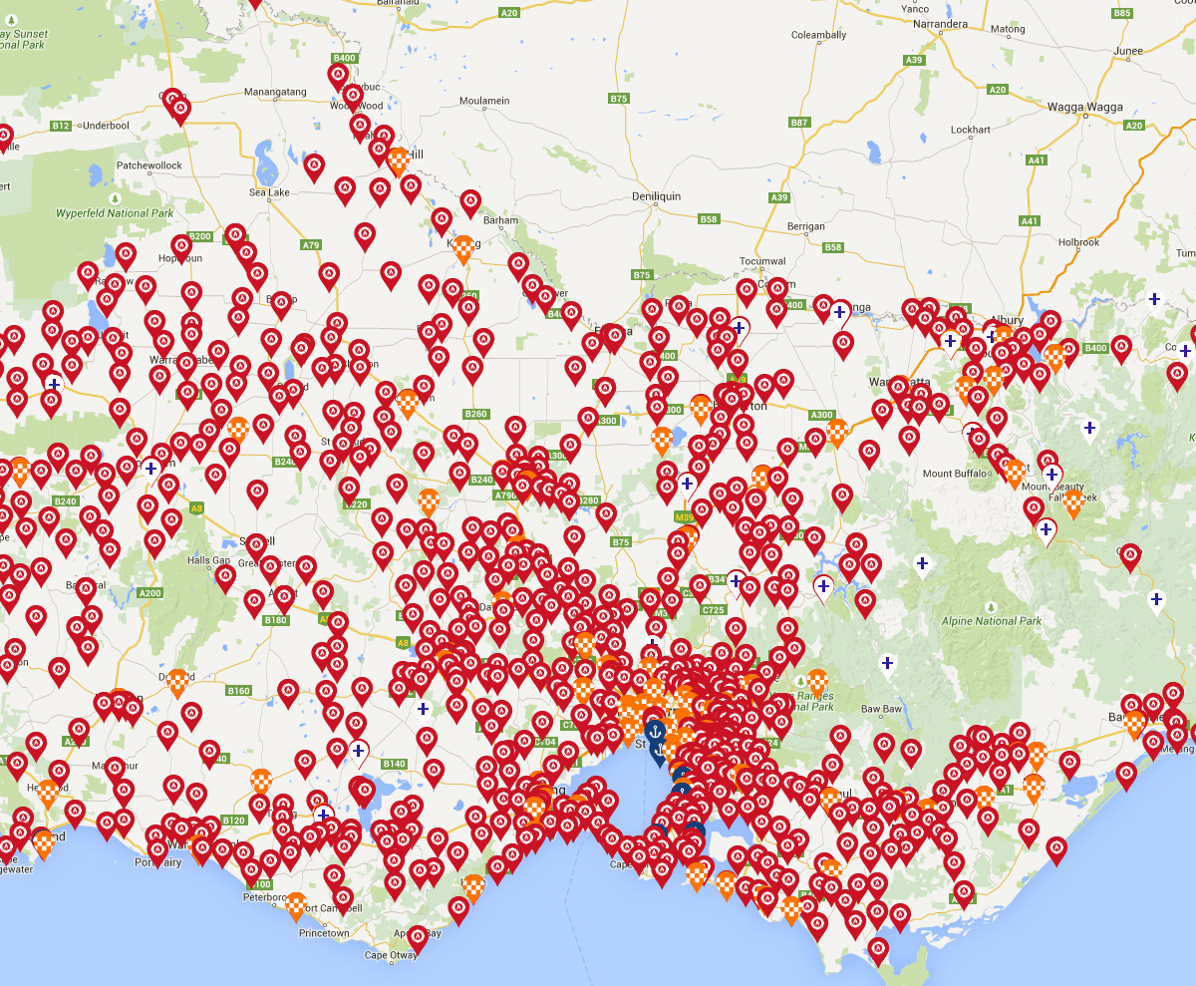
Embraced by over 24,000 Australians
The Adoption of BART

Slide 4
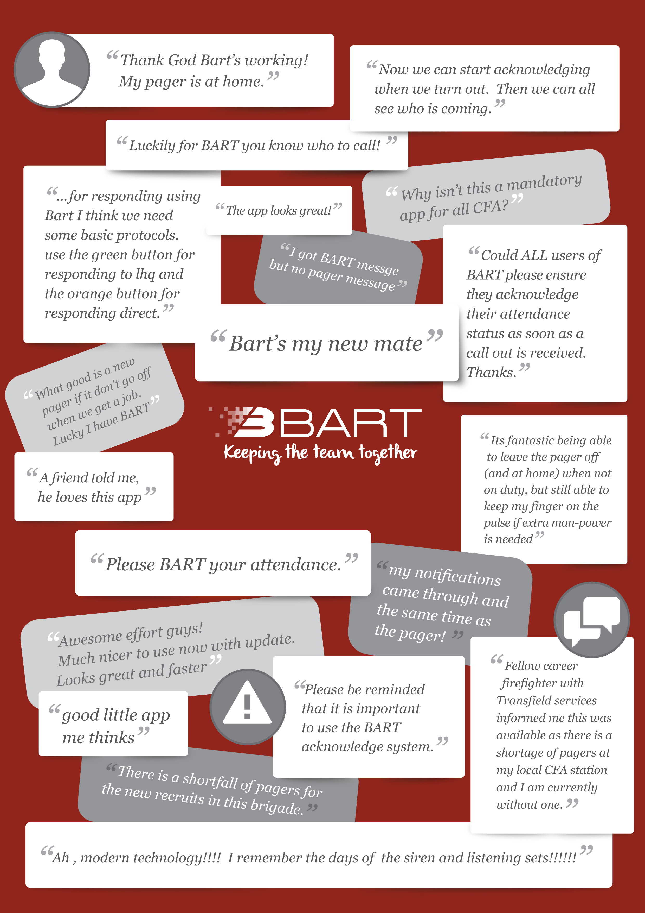

Slide 5
The BART Turnout Process

Slide 6
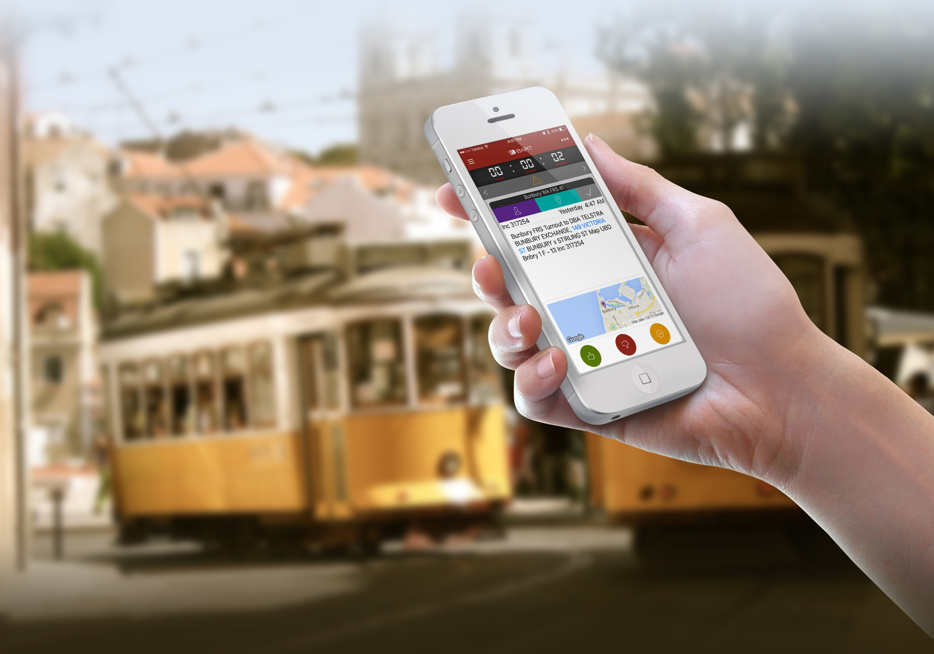
Message received

Slide 7
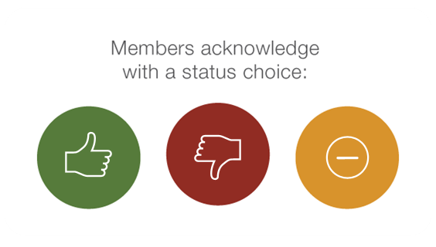
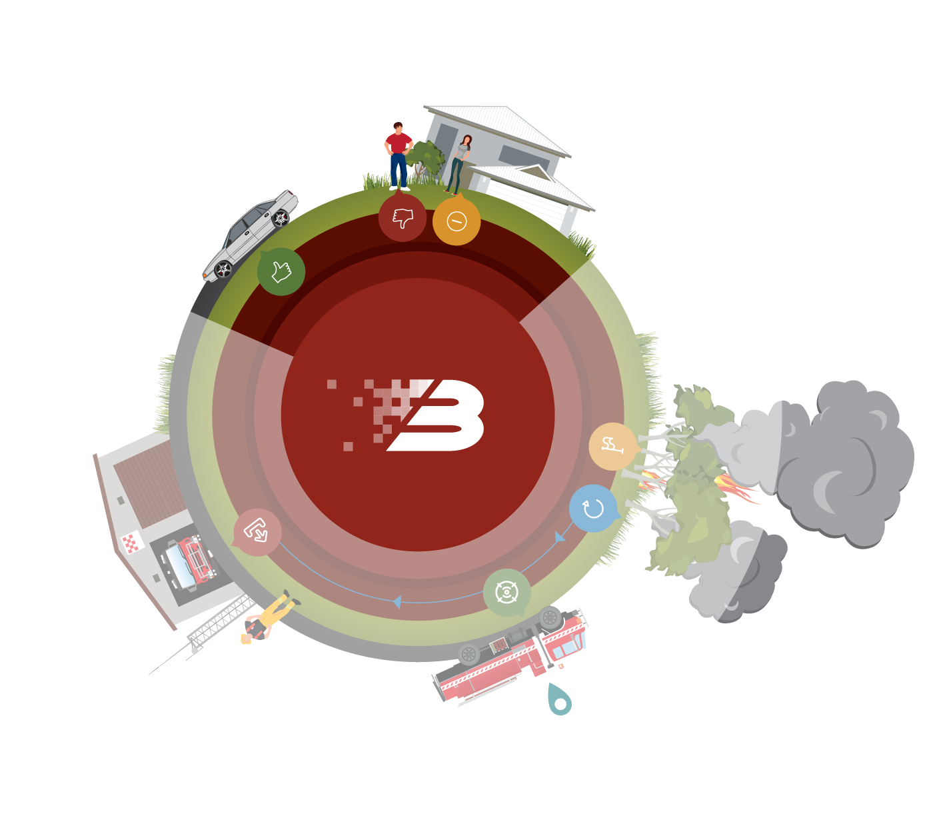
+ (optional)
Members respond in real-time

Slide 8
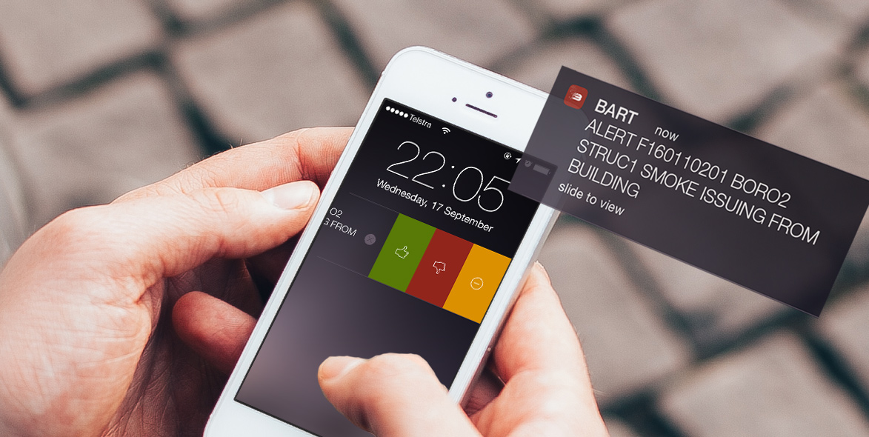
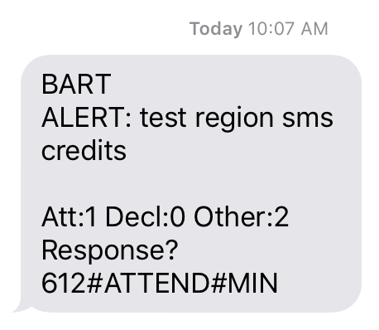
Smartphone Push Notification or SMS

Slide 9
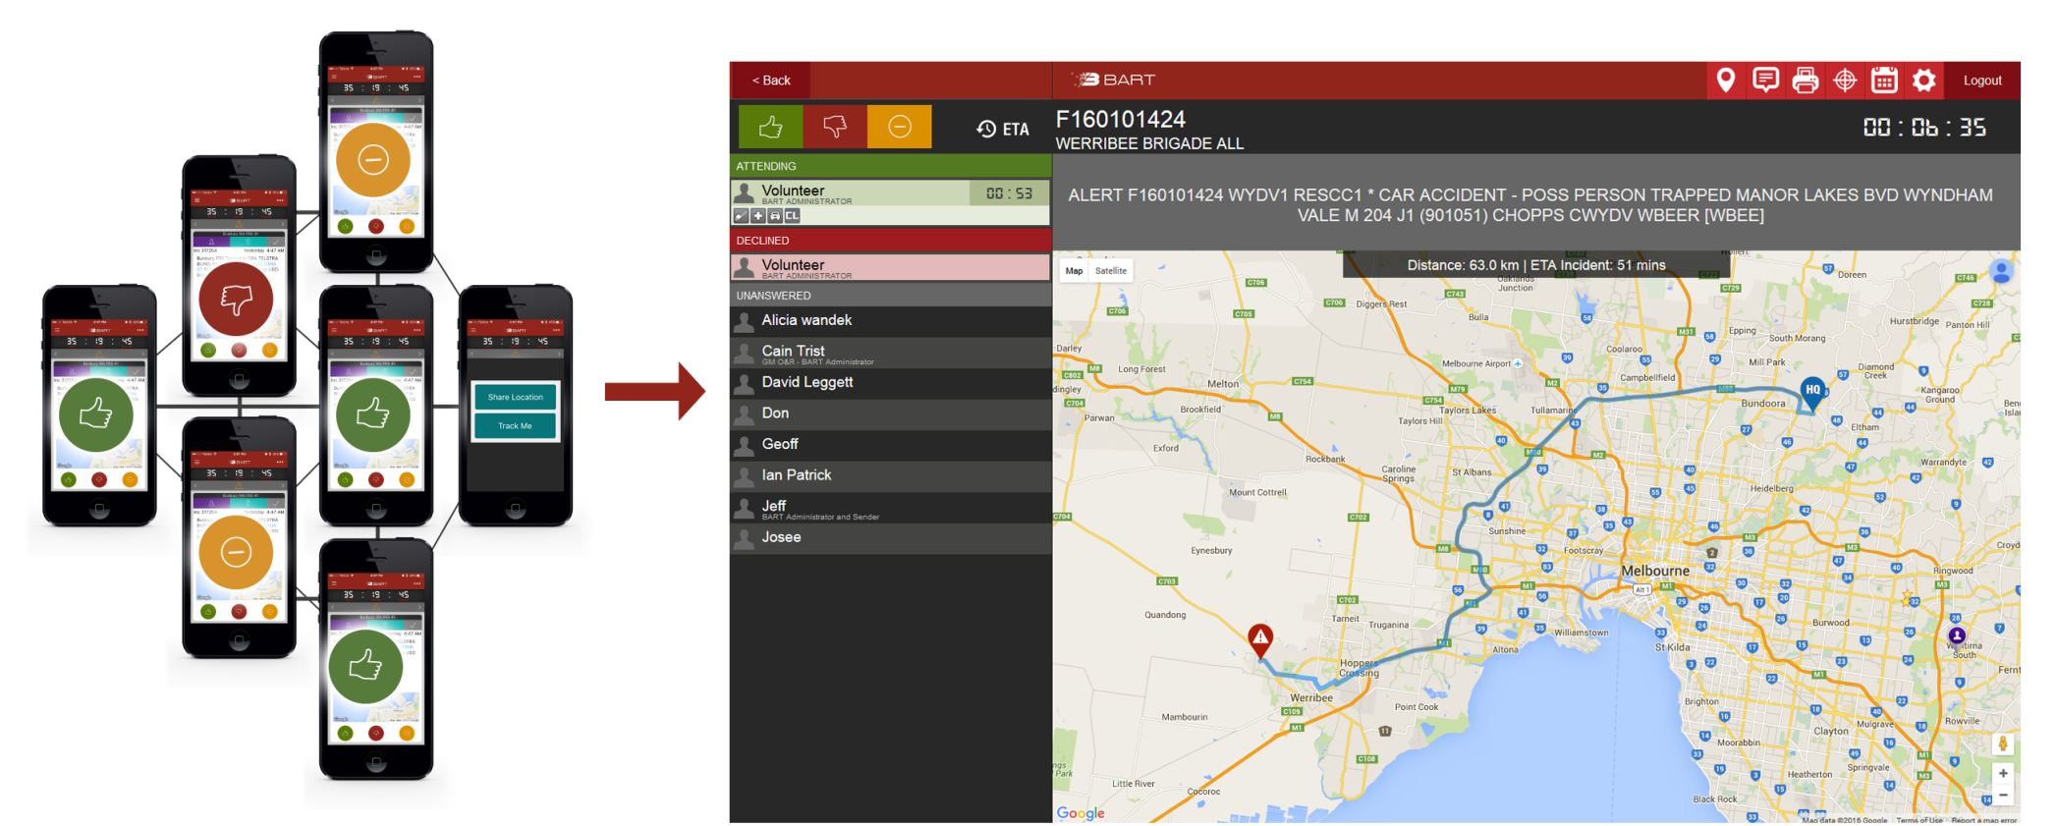
DASHBOARD

Slide 10
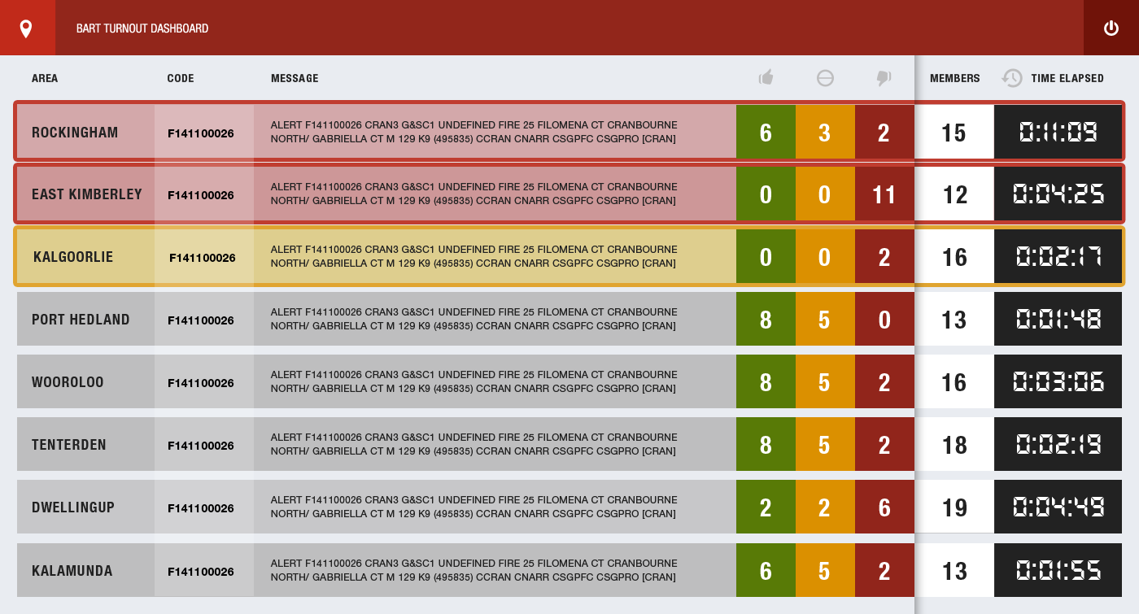
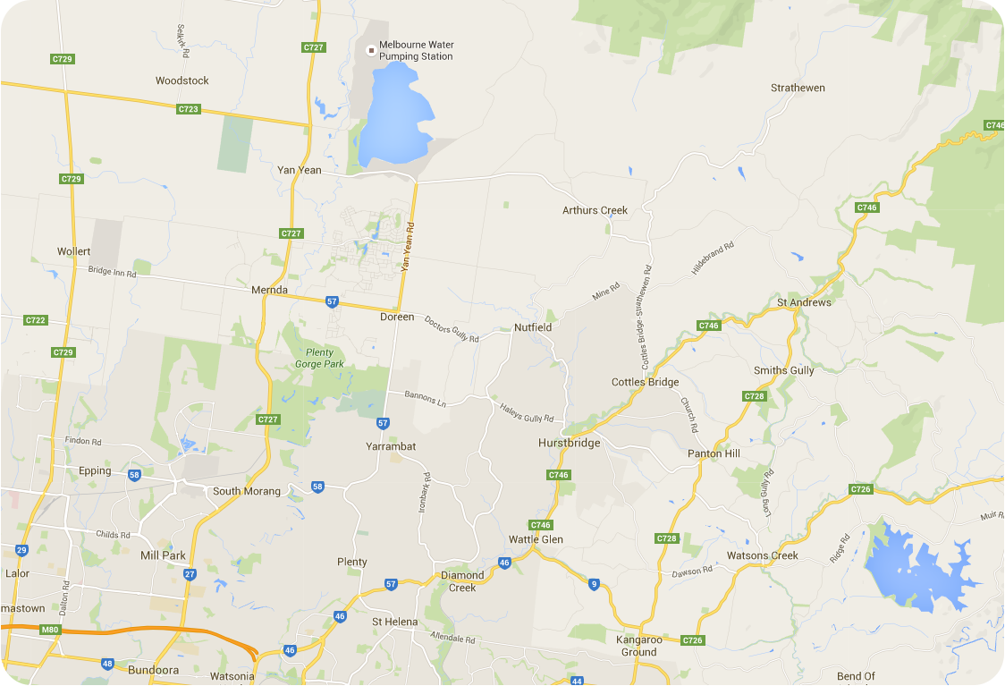
TURNOUT

Slide 11
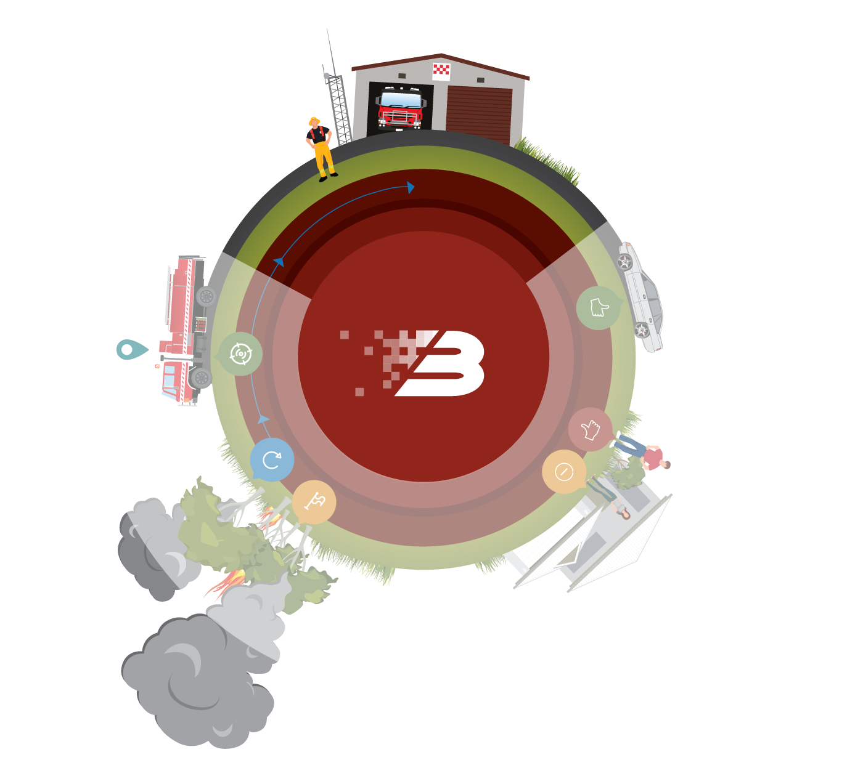
A vehicle is assigned to the incident

Slide 12
Assigned vehicle - real-time location

Slide 13
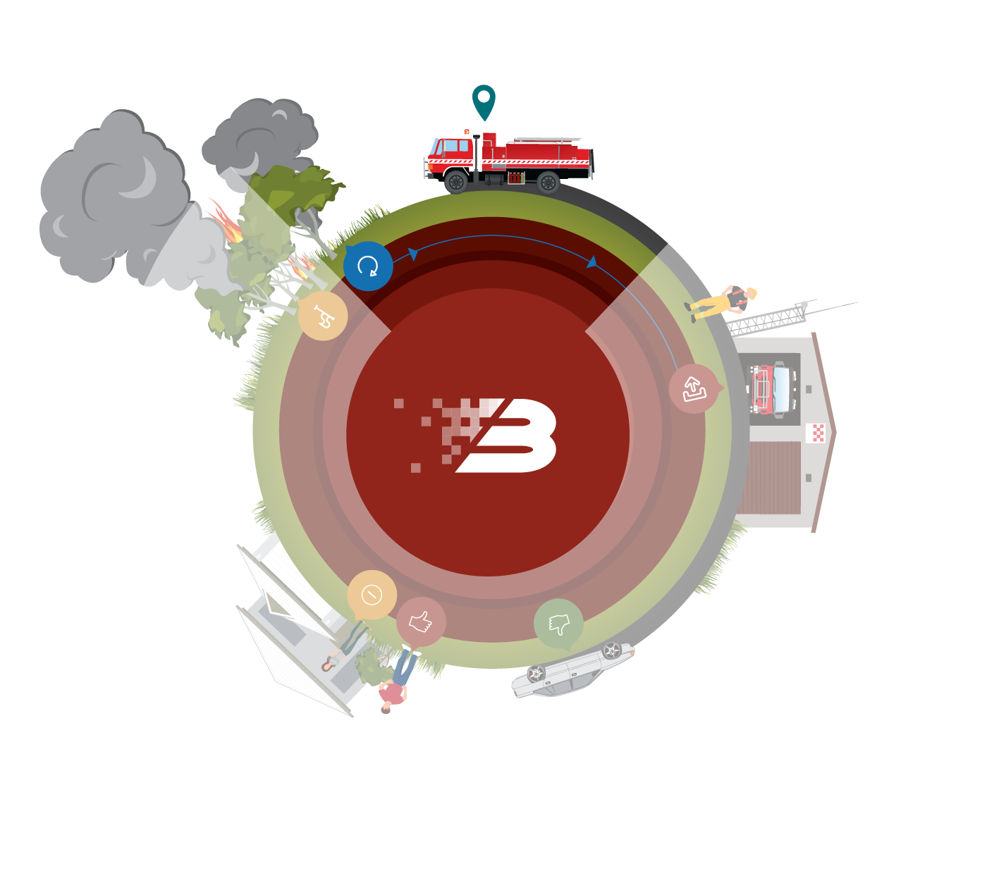
Vehicle is on its way to the incident

Slide 14
Vehicle en-route - real-time location

Slide 15
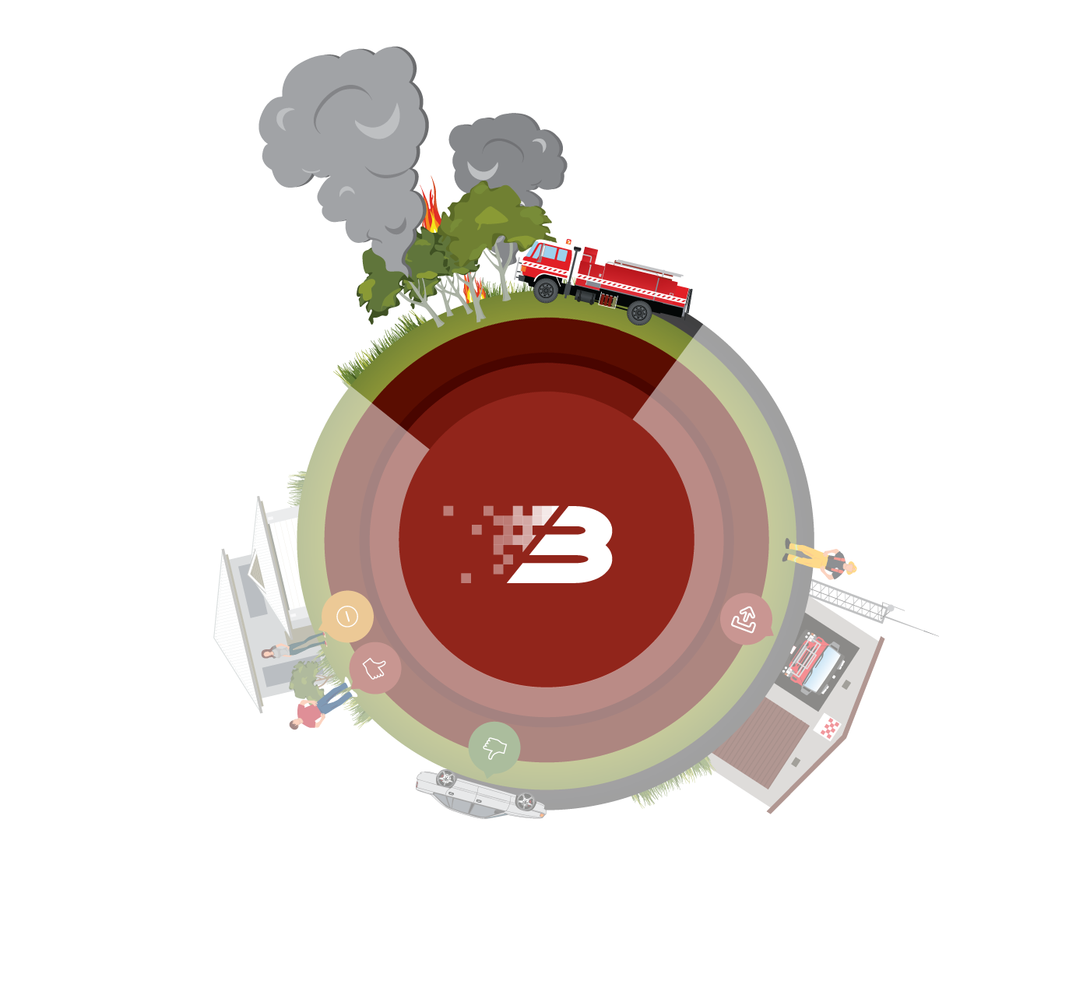
Vehicle arrives at the incident

Slide 16
Vehicle Arrival - real-time location

Slide 17
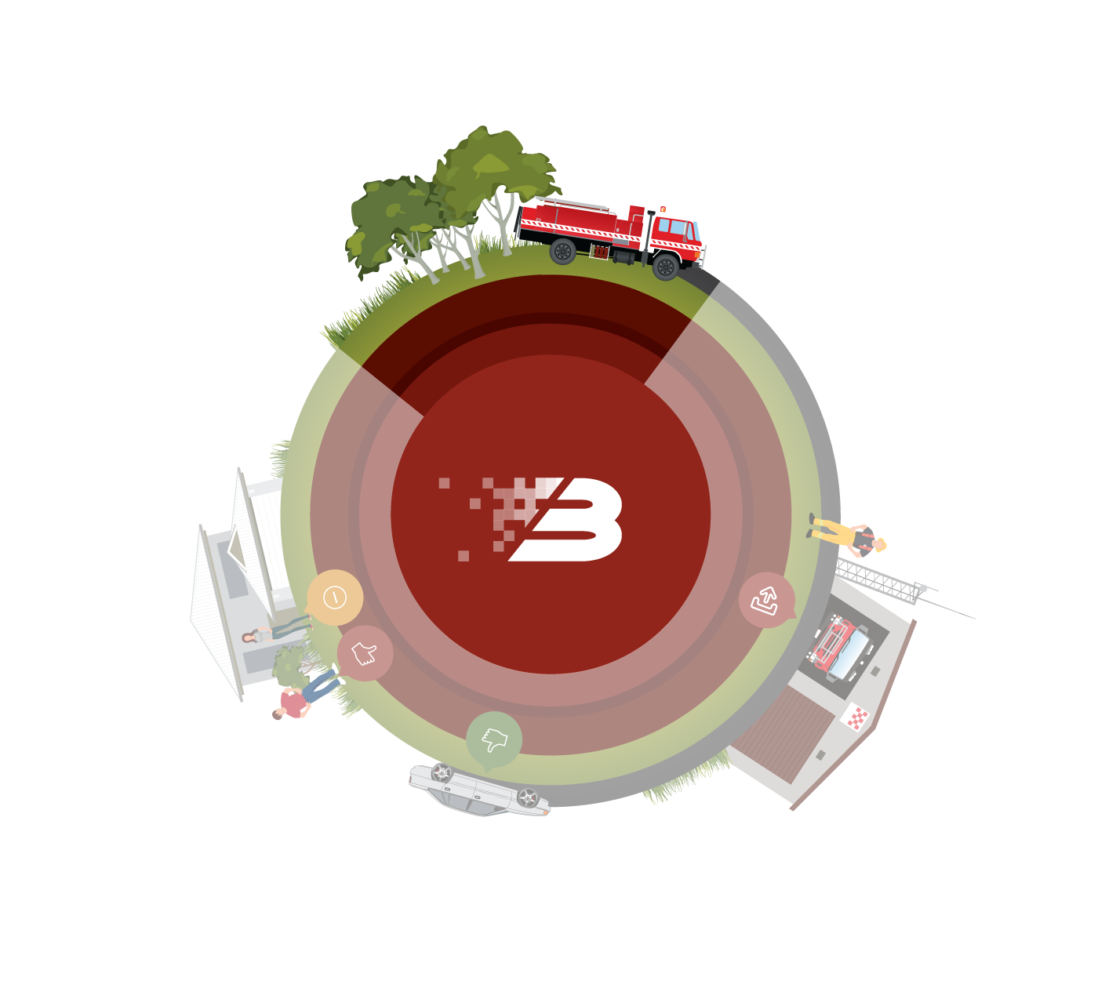
Vehicle returns to the station

Slide 18
Vehicle returning - real-time location

Slide 19
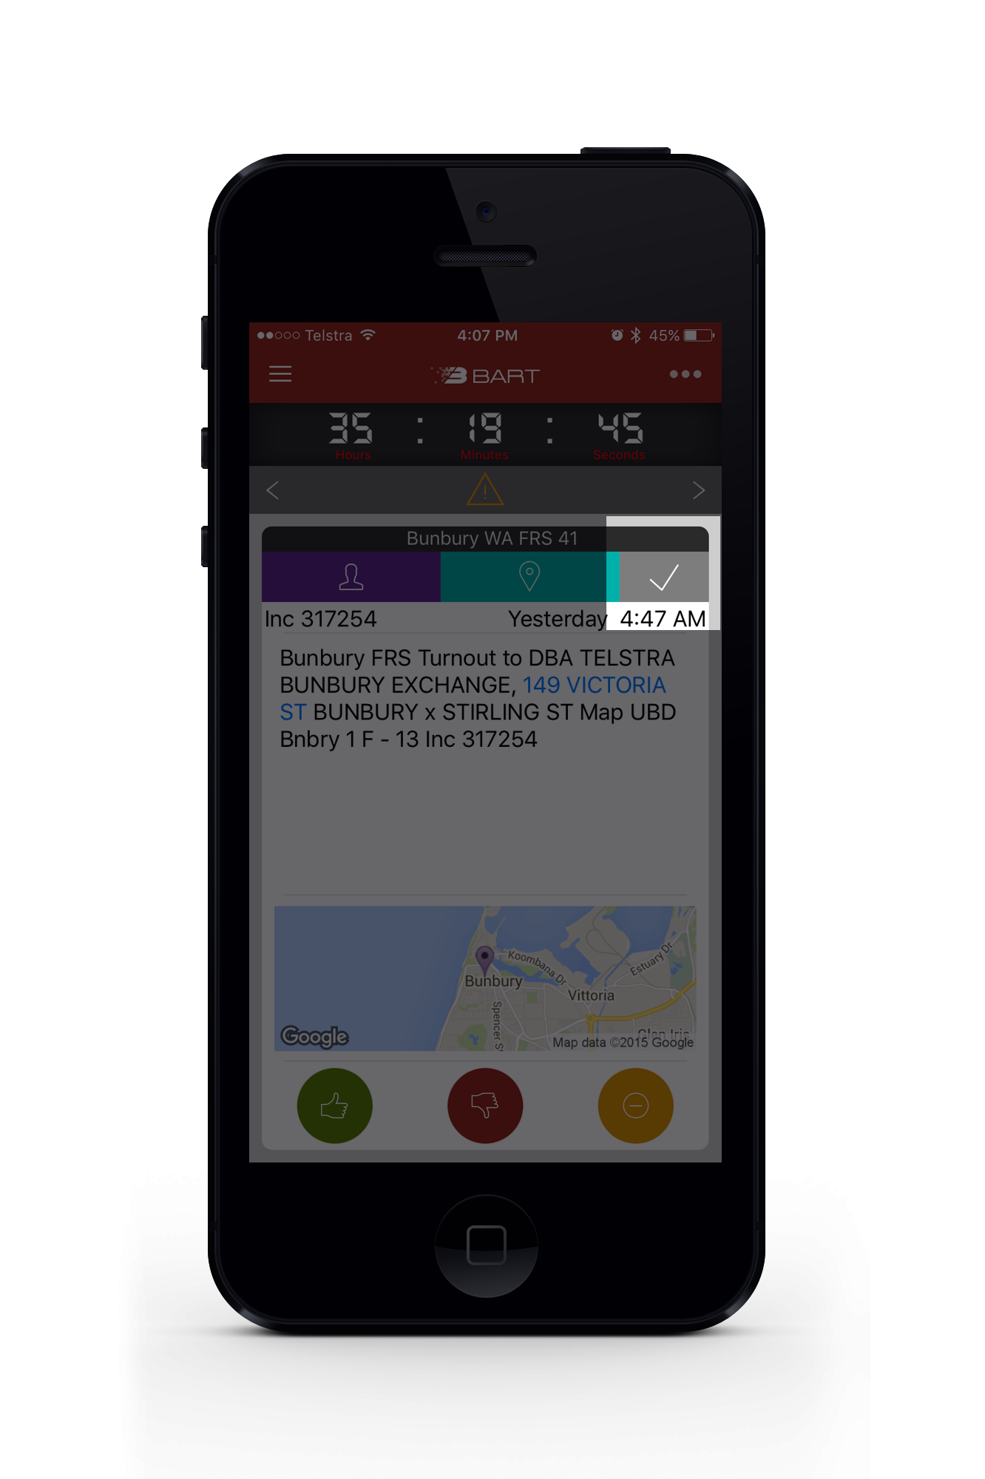
Job Completed

Slide 20
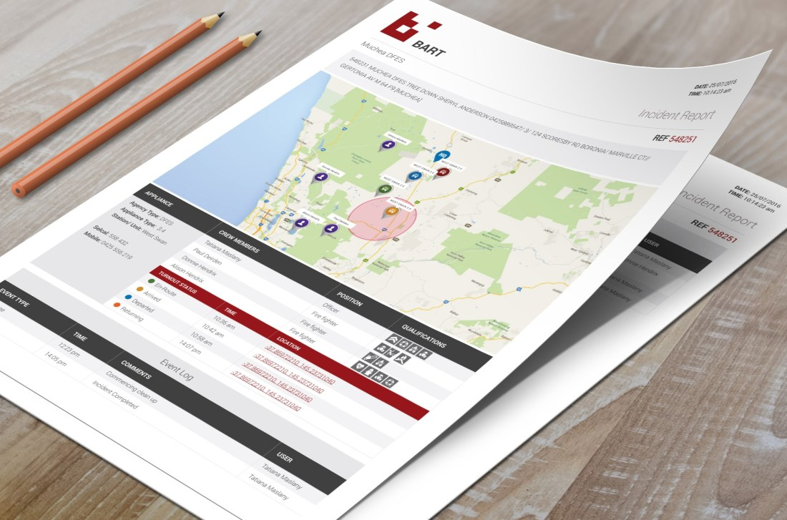
PDF Report produced on Completion
PDF Report on Completion

Slide 21
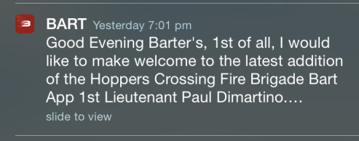
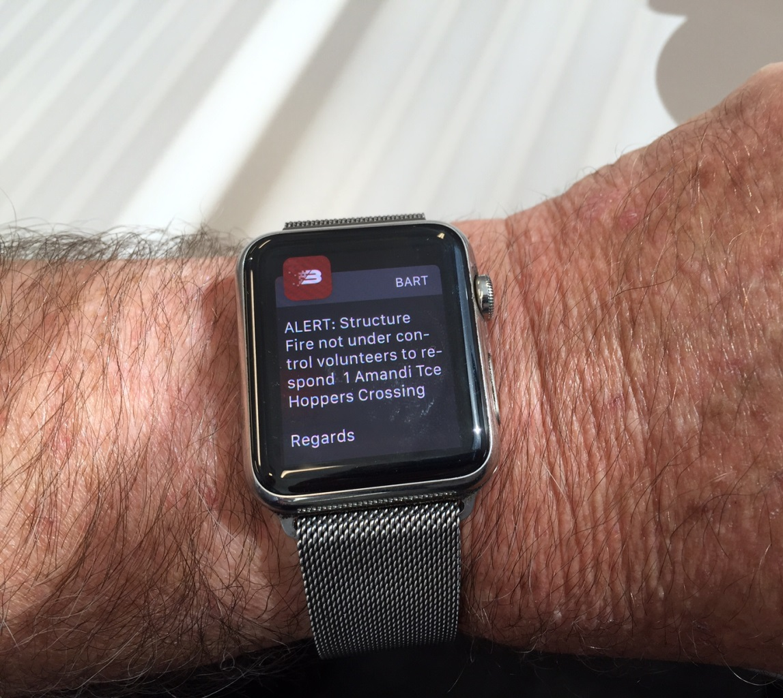
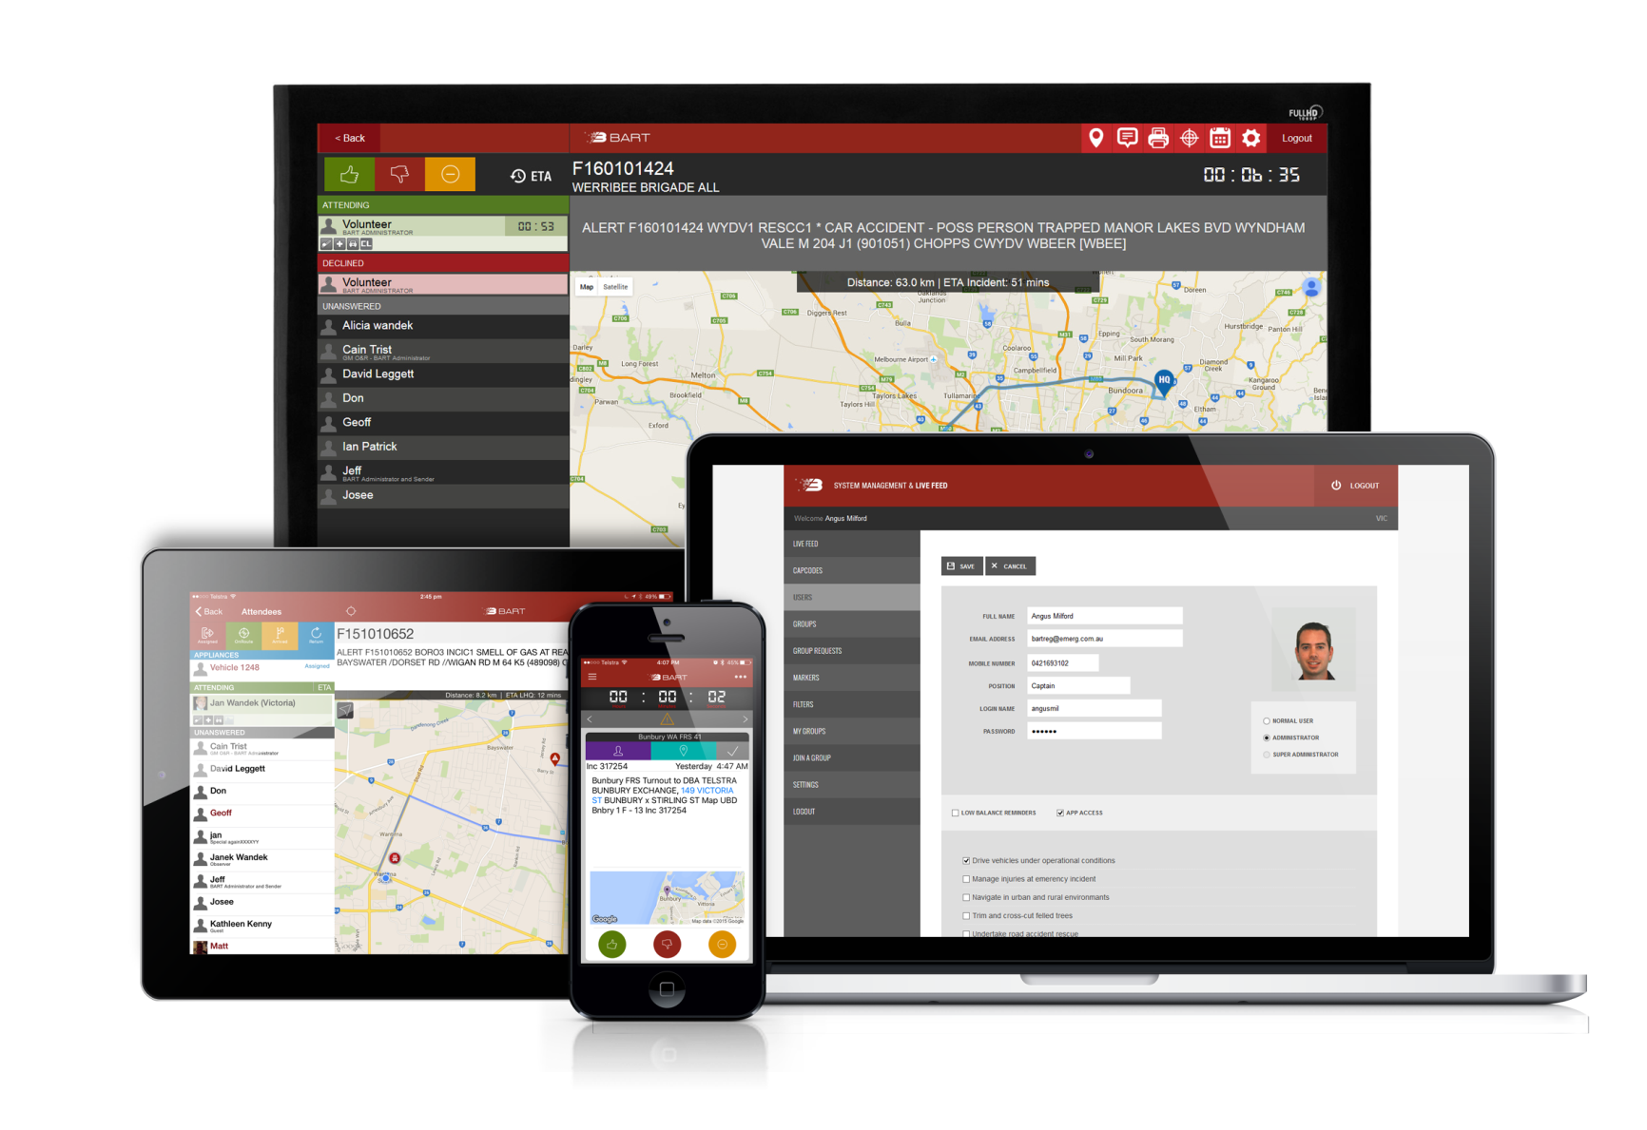
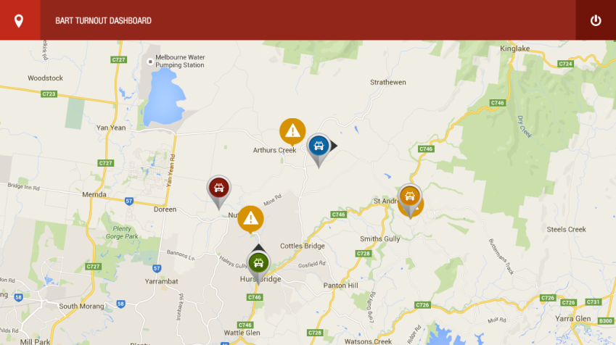
Emergency personnel working together
Notes:
Thank you for allowing me share what we have learnt so it may help you develop world standard App applications.
Happy to answer questions

Slide 22
BART Survey: RESULTS
99% indicated it was important to them.
25% gave examples where BART actually saved lives and property.
60% indicated more members responded to call outs with savings of 1-5 minutes
Emergency personnel LOVE using BART

Slide 23
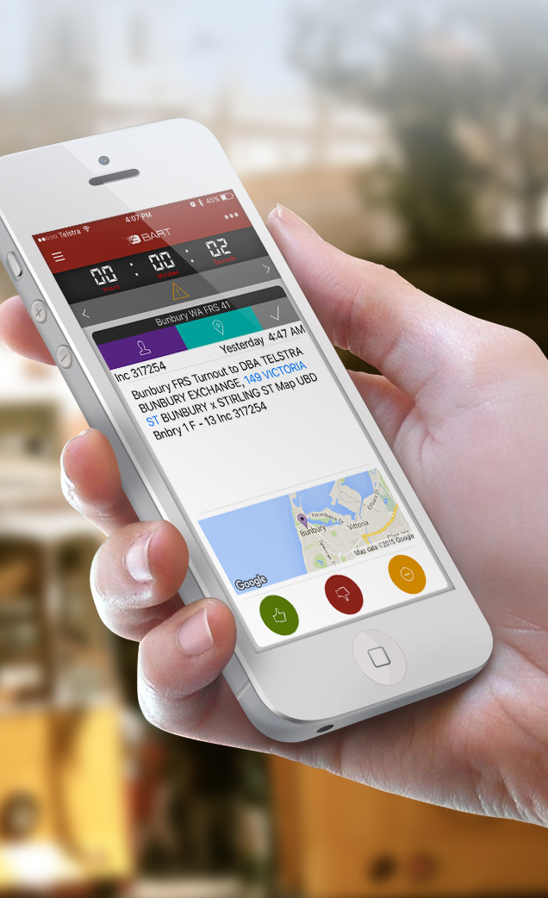
Summary: INDIVIDUAL LEVEL
All members have a direct line to the rest of their crew
All members within a team have access to ongoing, real time updates
Utilises a natural and common method of communicating
Vehicle and Member Map visualisation

Slide 24
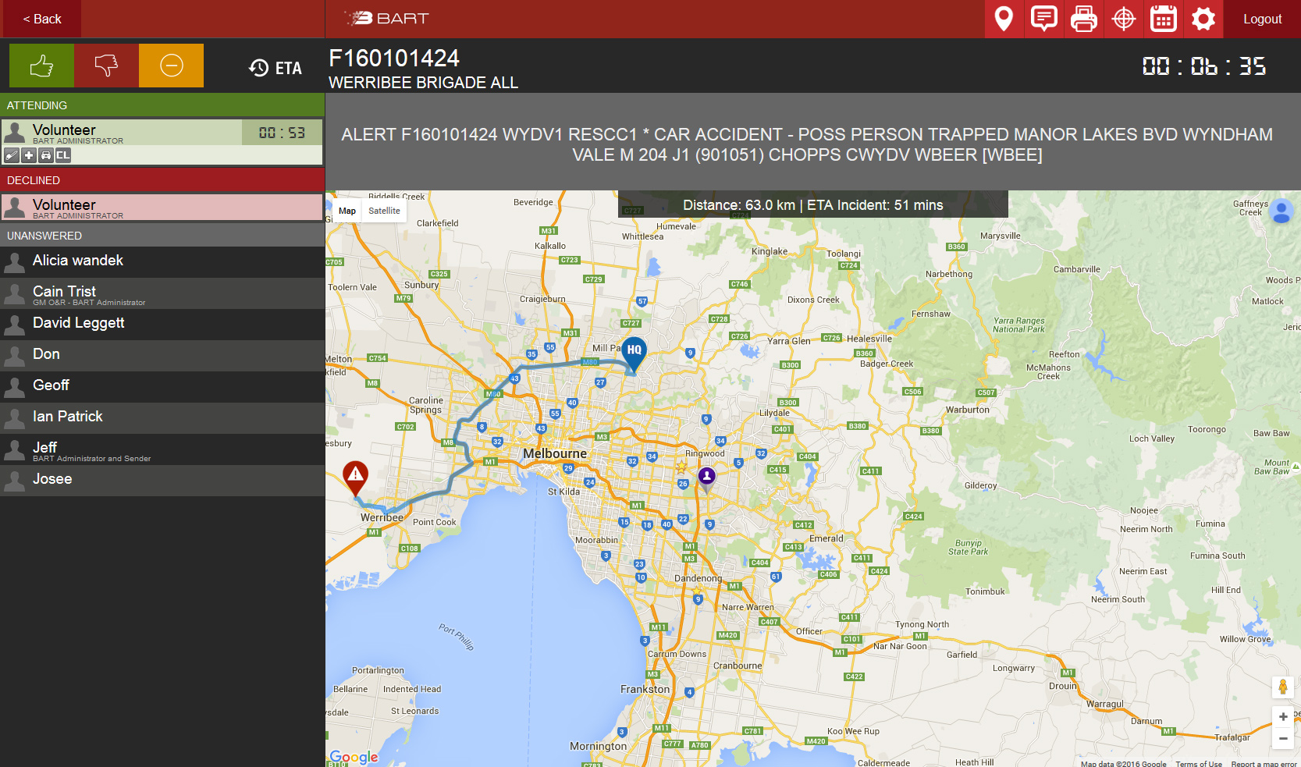
Summary: BRIGADE LEVEL
View incoming incidents, as well as a running list of those members attending the event
An estimated time of arrival for each member
Attending member qualifications are provided
Vehicle and Member Map visualisation

Slide 25
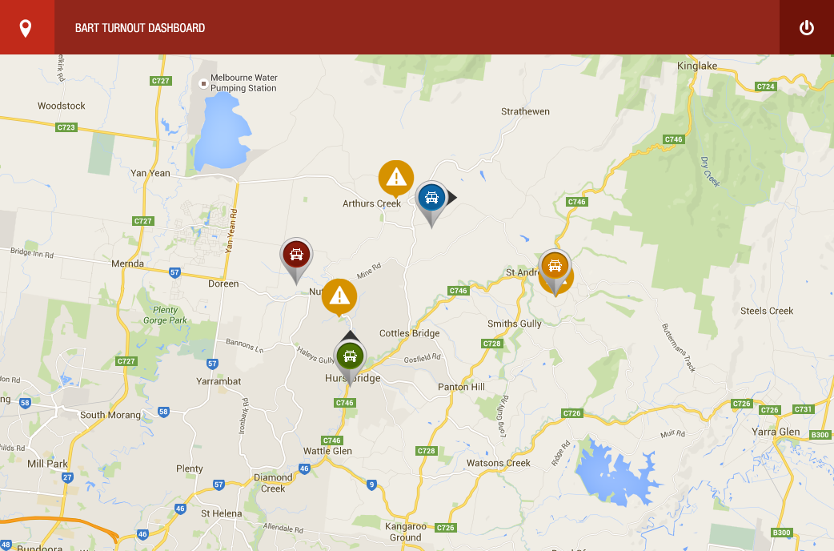
Summary: REGIONAL LEVEL
View the distribution of resources
View the status of trucks turning out to an incident and their current locations in real time
Identify incidents that haven’t been responded to within a specified timeframe

Slide 26
Summary: AGENCY LEVEL
Agency can view the incidents and turnout responses within entire regions, across different agencies
Complete situational awareness of events that are occurring across the state in real time
Vehicle Map visualisation

Slide 27
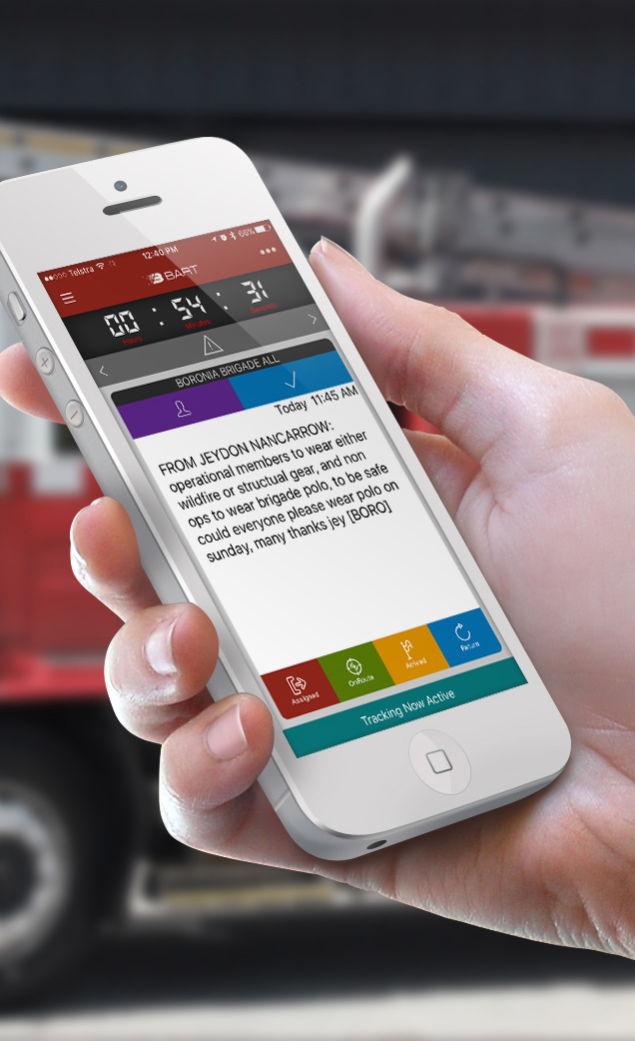
And Much More
Member availability
Team creation and management
Multiple group participation
Message sending with attachments
Group and team discussion
Fire hydrants and water points
External feeds
And more to come based on your suggestions

Slide 28
BART a complete solution for the entire turnout process

Slide 29
Thank You!
For more information, visit:
www.bart.emerg.com.au
Join the movement

