Slide 1
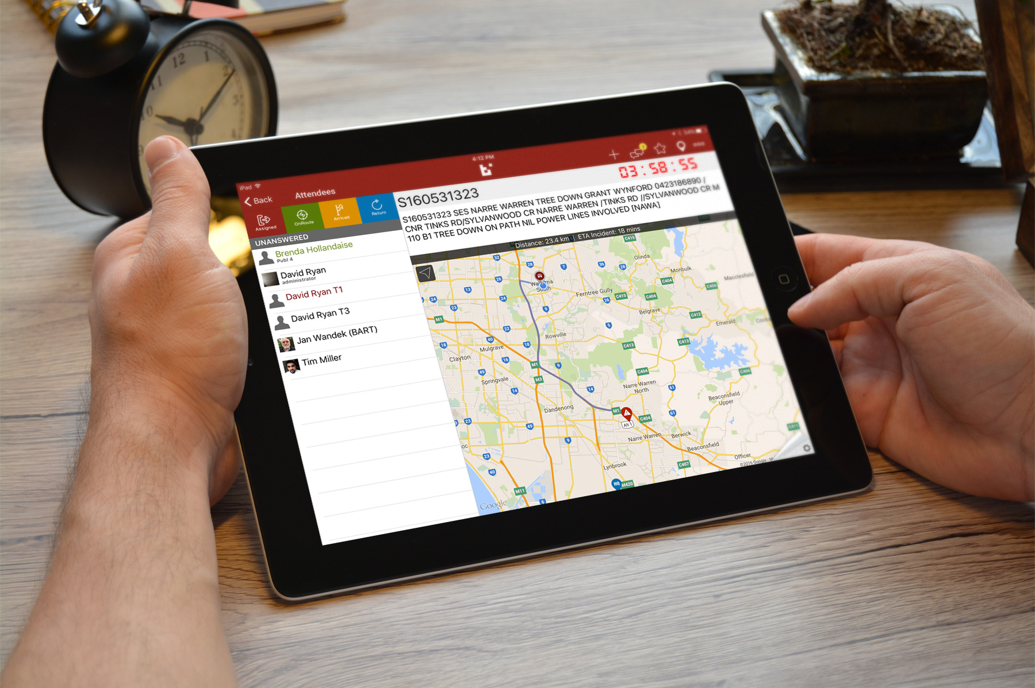
Tablet Application
For new BART users

Slide 2
The Dashboard
Note for presenter: Please print note pages for additional information by:
Click File
Print
Click Full Page Slides dropdown
Click Notes Page
then click Print

Slide 3
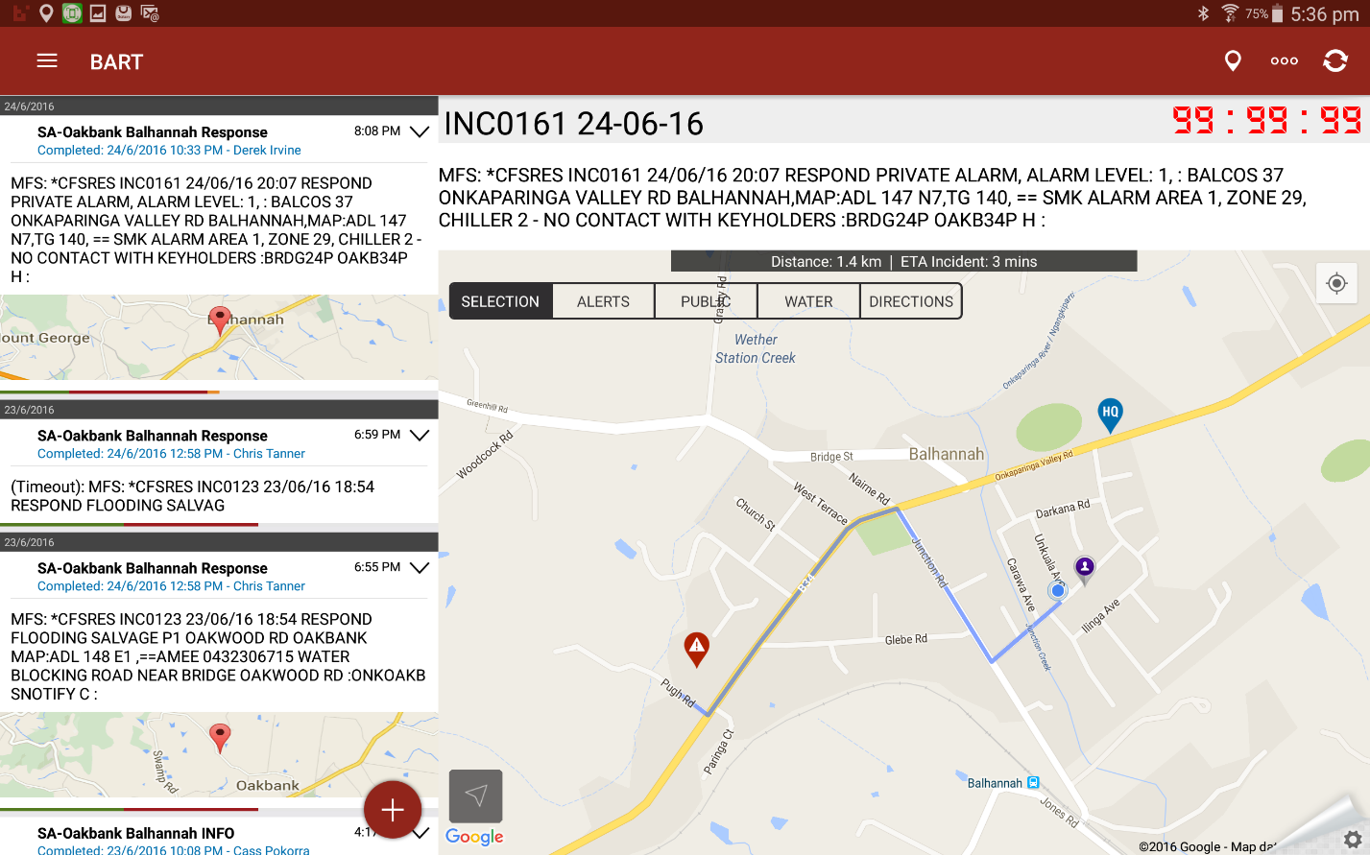
Start Up Screen
CFS Incident Number
Countdown Timer
Add a location
Pager message
Refresh
ETA to incident
Directions opens another App called Here Maps
Incident location
Vehicle location
Person’s location
Notes:
Use the incident number when you contact Adelaide Fire
Be aware that the count down timer might show Eastern Standard Time
Add location can be used to add a water point etc.
ETA shows the approximate time to drive to the location
You will only be able to see vehicles from your own brigade

Slide 4
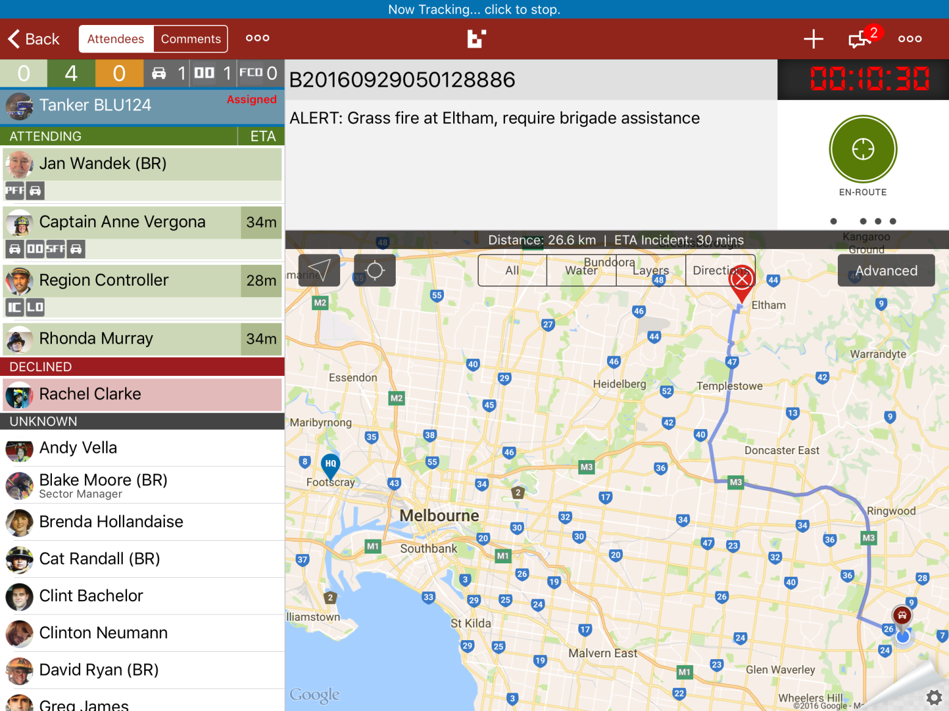
GPS Tracking
Appliances - assigned
Standard Status Buttons (swipe)
Notes:
It is important to hit Assigned to start GPS tracking
Before too long you will be able to check what time you have tapped these buttons via a status log

Slide 5
Attending
Attending
Not attending
Notes:
We need you to hit the thumbs up and thumbs down so the GDO knows if you have a crew available to attend the incident
A crew builder feature will be available soon. This will enable the fire fighters to update their own vehicles crew names while on route to the incident

Slide 6
Other Information
Attending
Other. To be used by GDO
These 3 boxes are qualifications set by the Group
Appliance
Vehicle status
Notes:
The number boxes don’t always correspond to those attending and not attending. I think this is because the smartphone app needs the latest version for this feature to work
The qualification boxes will be Driver, CABA and RCR

Slide 7
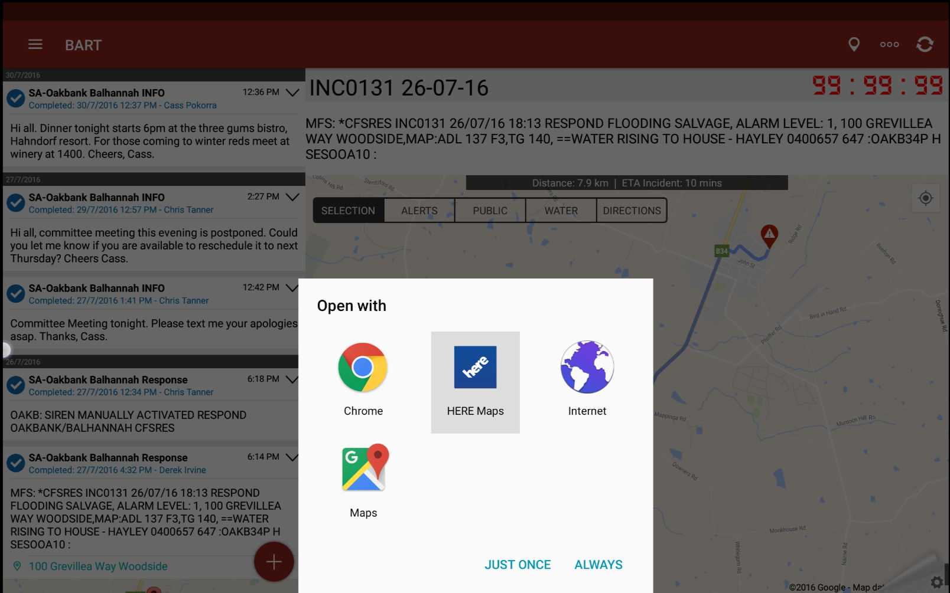
When you tap ‘Directions’ it will bring up an ‘Open With’ option box.
Choose: ‘Here Maps’
‘Here Maps’ will recognise a Rural Address
Directions
Notes:
Don’t always rely on the location to be accurate

Slide 8
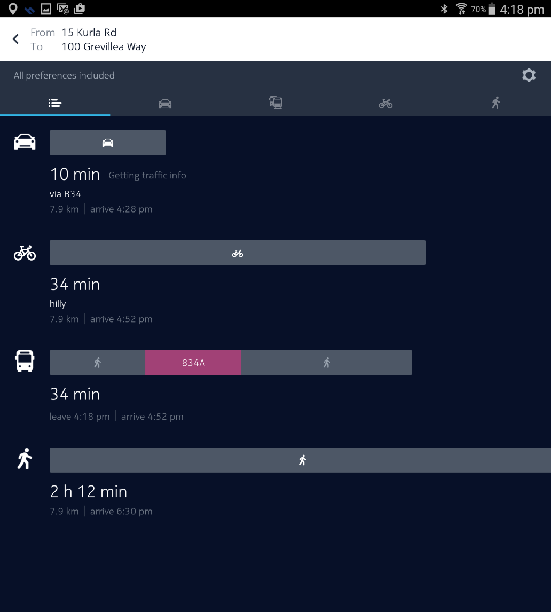
Choose Car
Not bicycle although it is getting more popular
Not bus. This is not a good option!
You definitely don’t have time to walk plus you will need the truck
Next
Notes:
Use a bit of humour
It is important to select Car

Slide 9
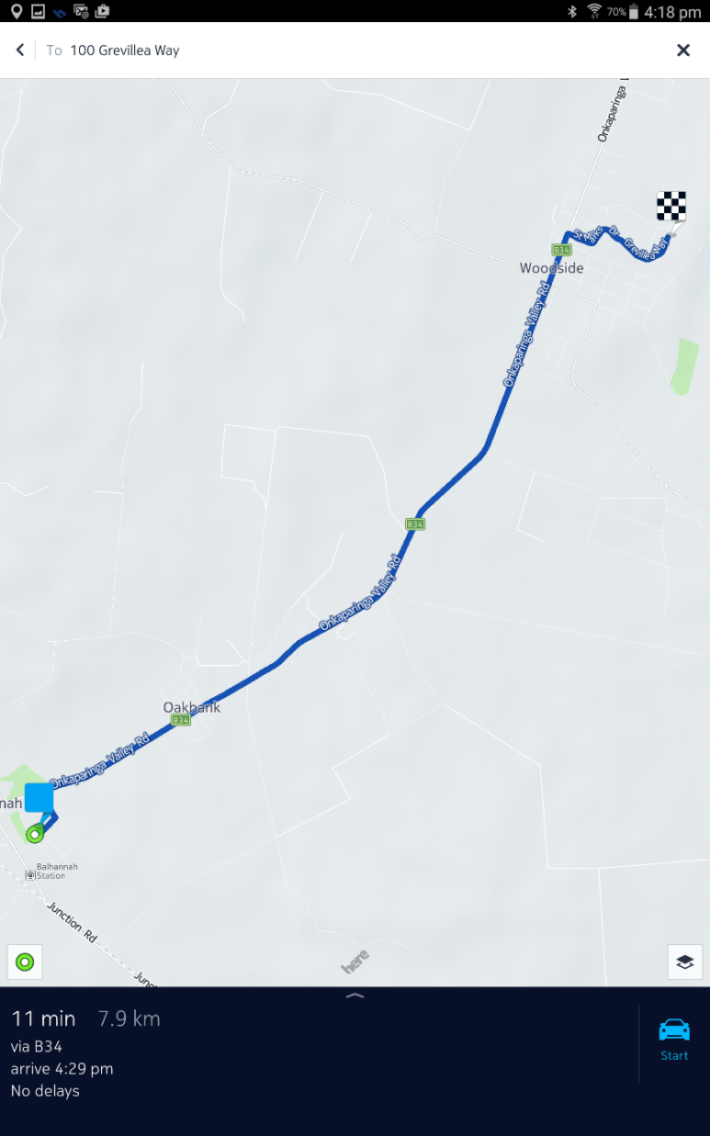
Last Step
Click Car
Notes:
Once you tap car it will start voice and map navigation

Slide 10
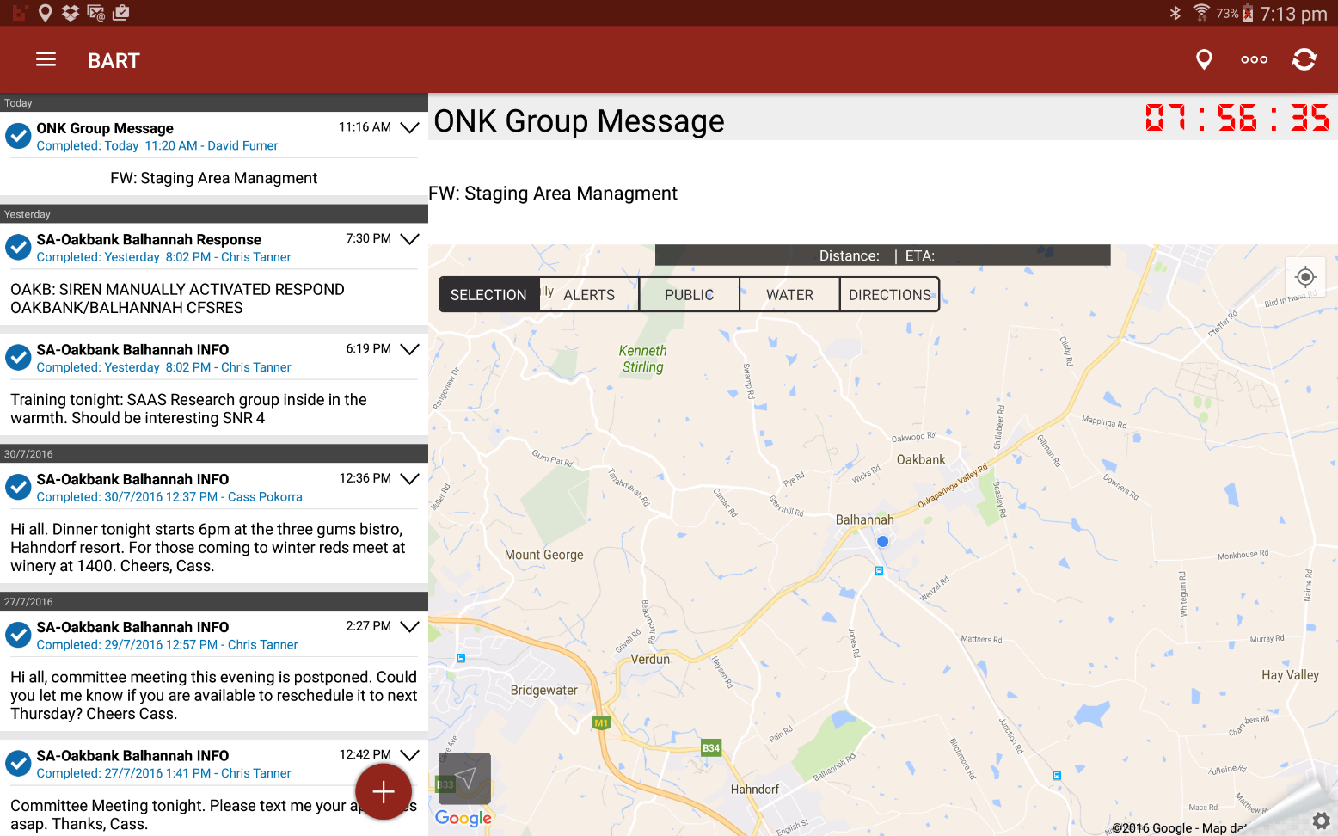
Other Features
A Broadcast will appear in this list
Don’t mark complete until you have returned to the station
Tap to send a Broadcast
Notes:
When you send a Broadcast it will appear in amongst the list of incidents
Emphasise not to mark a job complete until the vehicle is back at station and ready to respond. This will be the standard for the Group

Slide 11
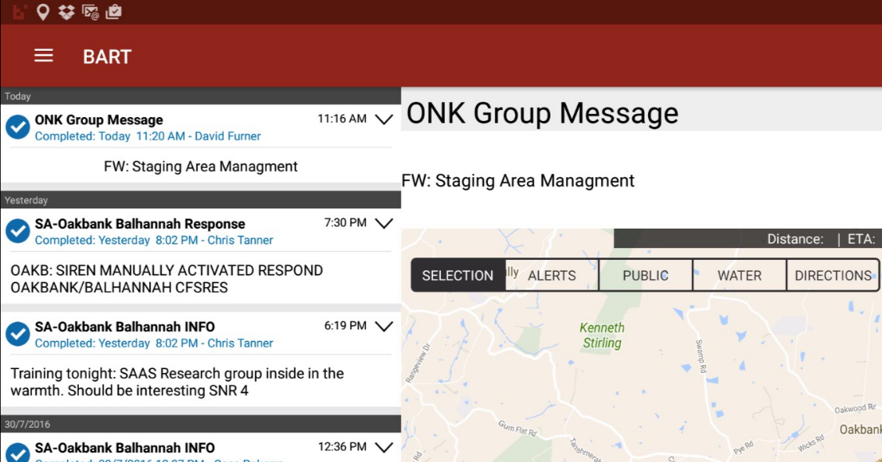
Settings
Tap the 3 Bars to bring up more options
The Settings Menu
Most users won’t need to access the Options Menu
Notes:
Users may need to use Settings to log out of the app to reset the applications

Slide 12
Summary
The ‘must do’ is to tap:
Acknowledge
En Route
Arrived
Departed
Back (at HQ)
This will start GPS tracking so we can see you on the Dashboard and the Regional Platform
This will also log your status via the internet. The person completing your fire report will be able to view time on scene etc.
Notes:
Reinforce that it is important to use these buttons. We need to know where vehicles are on the fire ground

Slide 13
?
Questions?

